Slide 1
Source Approval Request (SAR) and Qualification Requirements Familiarization
Mr. Steve Logan
AFLCMC/LPE (Propulsion Engineering)
(405) 734-4881 or DSN: 884-4881
Email: steve.logan@us.af.mil
DISTRIBUTION A Approved for Public Release; Distribution Unlimited. Destruction: 100% Shred

Slide 2
Overview
Source Approval Request
  Qualification Requirements
SAR Construction and Evaluation
  Elements and Evaluations
  Overall SAR Process
  Outcomes
Site Survey
Questions
References
Notes:
Trade Secrets Act 18 U.S.C. 1905
A Federal Employee Who Publishes, Divulges, Discloses, or Makes Known in Any Manner or to Any Extent Not Authorized By Law Any Information Coming to Him in the Course of His Employment or Official Duties
Relates to the trade secrets, processes, operations, style of work, or apparatus, or
Relates to the identity, confidential statistical data, amount or source of any income, profits, losses, or expenditures of any person, firm, partnership, corporation, or association;
SHALL be fined, or imprisoned for not more than 1 year, or both; and
SHALL be removed from office or employment.
Does NOT apply to contractors

Slide 3
BLUF
USAF Seeking Focused SARs
Reducing Qualification Effort
Find the Established Qualification Requirements
Construct Complete SARs
Submit SARs
Provide Missing Data, if Required
Take Action Based on Determination
  Bid
  Resubmit
  Track Approval

Slide 4
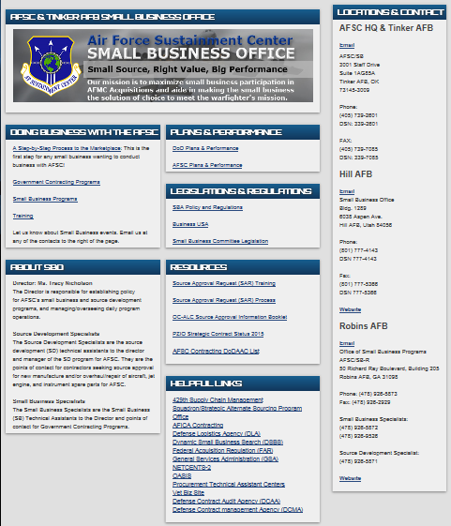
AFSC/SB Small Business Office
L.L "Chip" Chambers AFSC/SB (405) 739-2601 Email: afsc.sb.workflow@us.af.mil
Responsibilities:
Liaison between Government and all businesses
••Source Approval Requests (SARs)
•Sources Sought Synopsis (SSS)
•Outreach
http://www.afsc.af.mil/Units/SBO.aspx
SBO is the Front Door

Slide 5
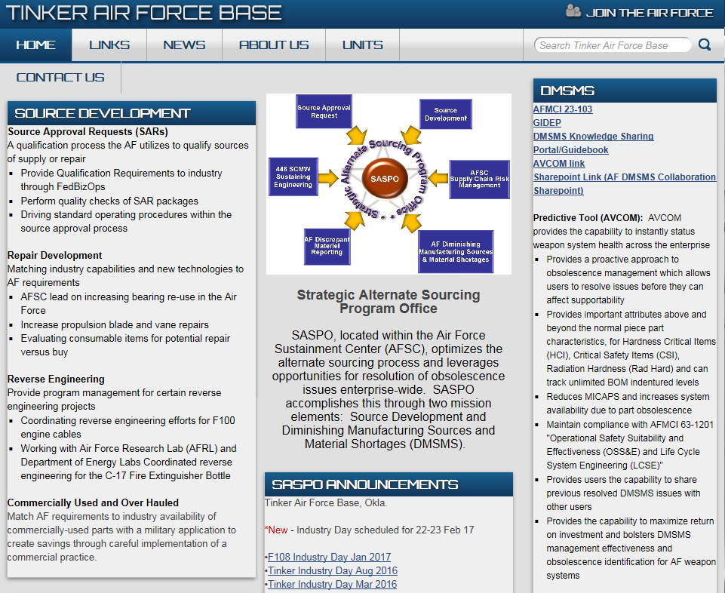
Strategic Alternate Sourcing Program Office (SASPO)
SASPO provides the Spark

Slide 6
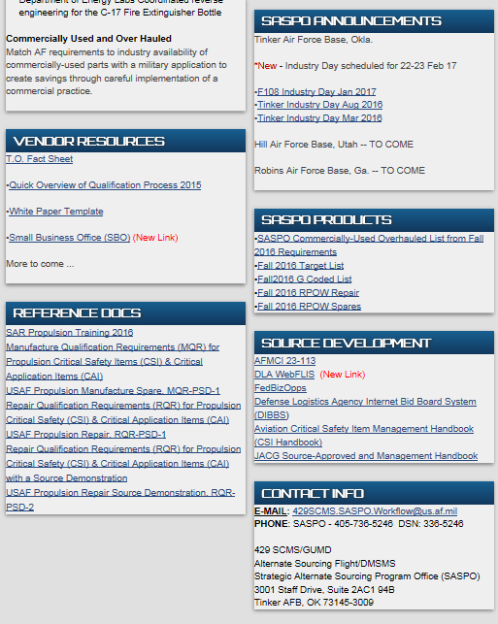
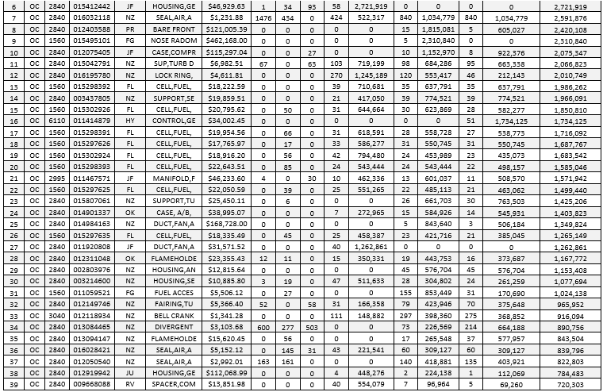
SASPO Resources
SASPO Target Lists
Target List
Training
The 36 Month SASPO Target List is provided every 6 Months and extracted from RPOW,
G Coded
C Coded
Surplus Overhaul
23-113
MQRL
**Disclaimer** The projections may not generate due to variability in demand. The forecast data is for planning purposes only and is not a commitment by the government to purchase the described items.
POCs
SASPO is the Front Page

Slide 7
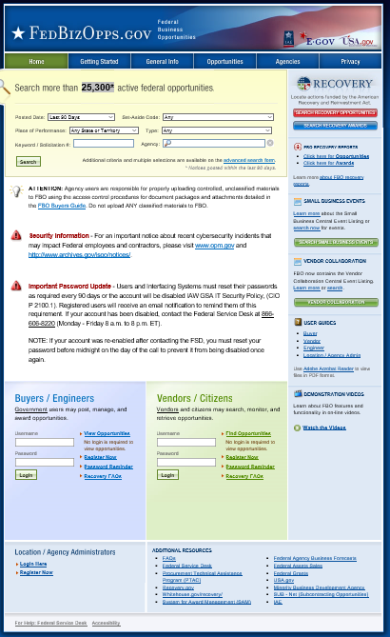
FedBizOpps https://www.fbo.gov
Seek the NSN(s) from any of the target the lists to determine the bidding information and the bid date
Review and if you have any question please direct them to the POC.
  Only the POC can provide answers to your question
The system is a web-based portal which allows review of Federal Procurement Opportunities over $25,000.
Search by NSN, Part Number or Key word
No Account Required
FBO is Key to Data and Dates

Slide 8
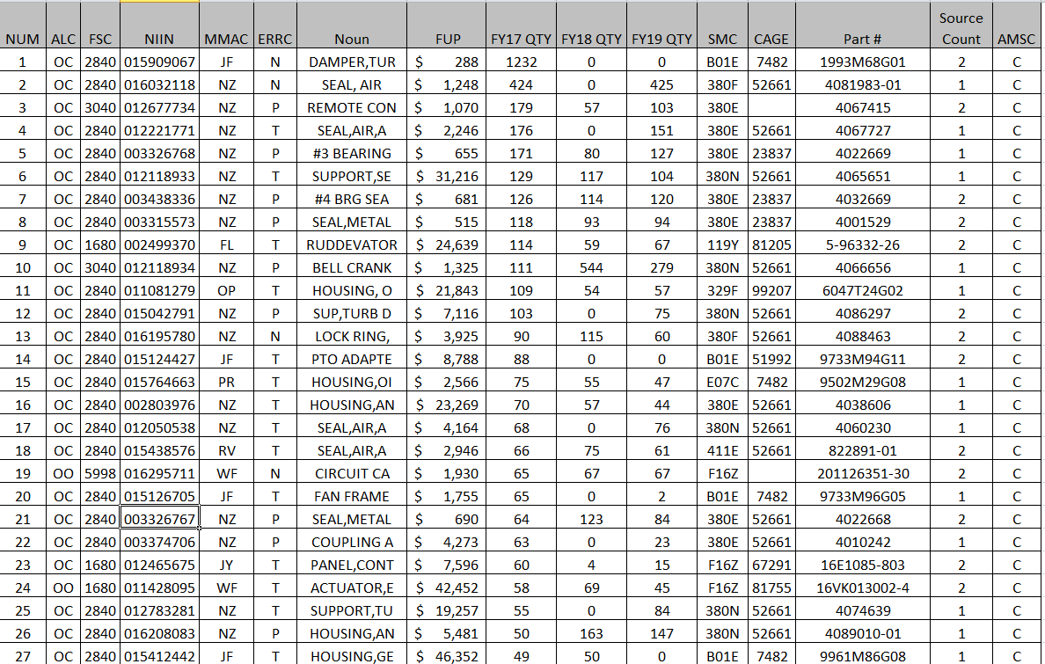
FedBizOpps Start
Select the Keyword or NSN from the SASPO Target List
Enter it into FBO
2840003326767

Slide 9
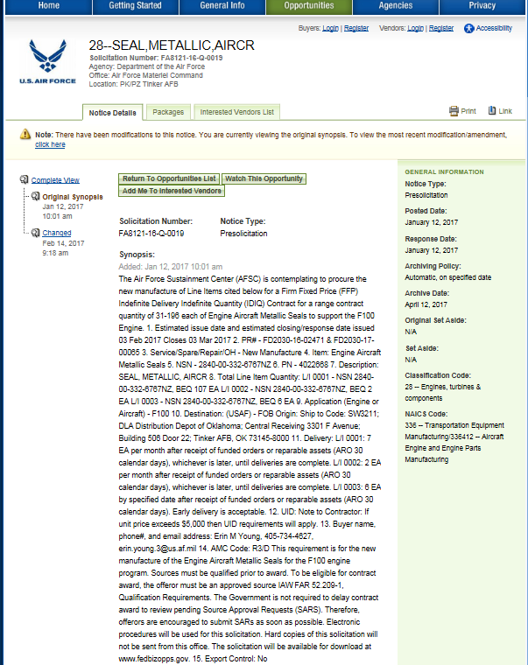
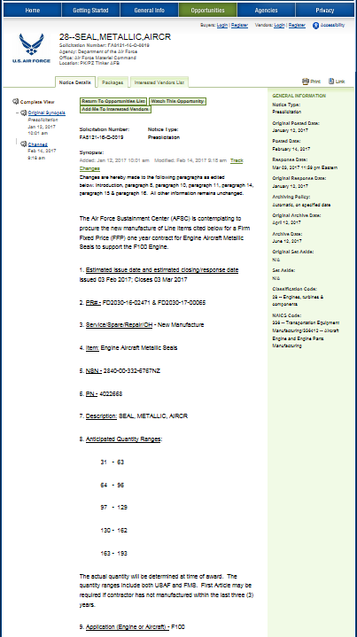
FedBizOpps Search
FBO Results can yield data and QR
If no QR is listed return the SASPO Site and determine if QR is available
If not found contact SBO

Slide 10
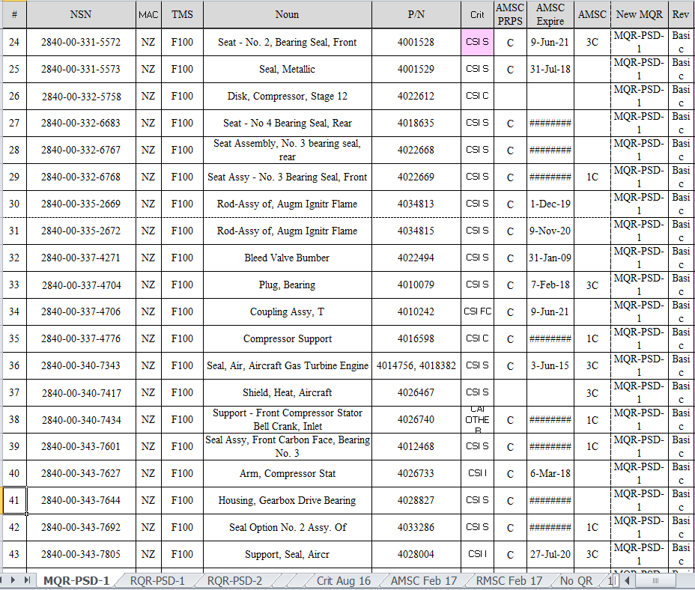
Propulsion Master QR Listing
Located on SASPO Site and FBO
Keyword Search
  NSN
  Part No.
  Noun
  Solicitation
QRs
  MQR-PSD-1
  RQR-PSD-1
  RQR-PSD-2

Slide 11
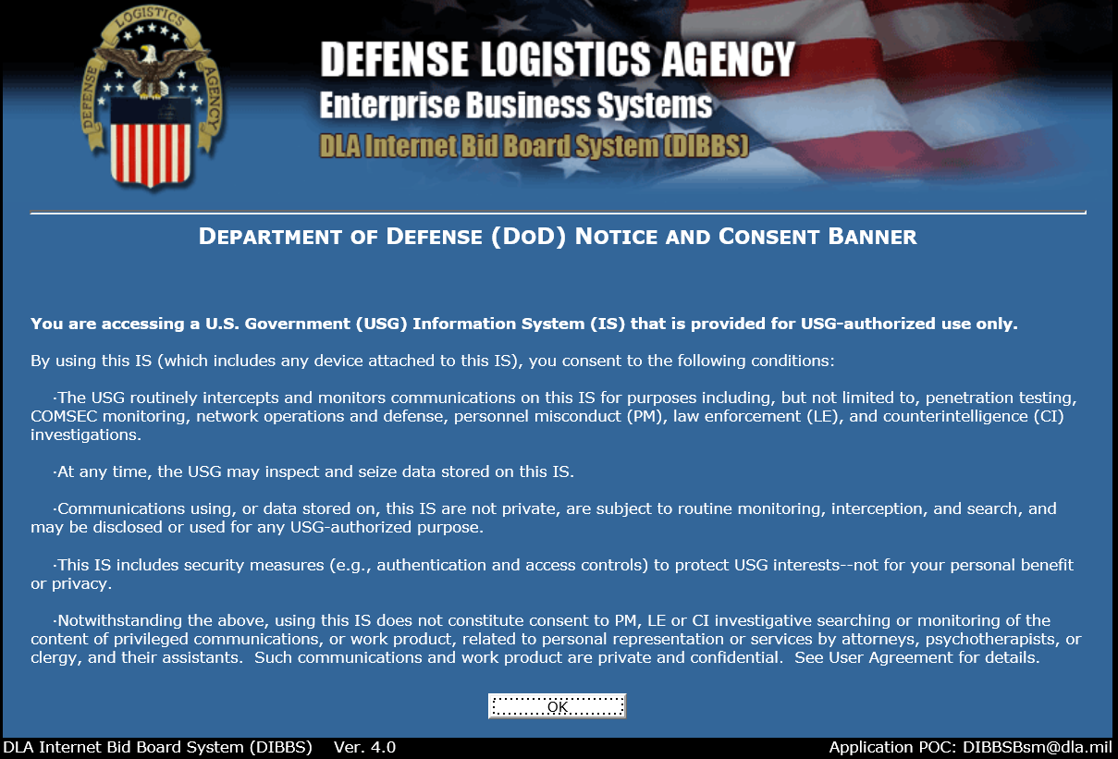
DLA Internet Bid Board System (DIBBS)
https://www.dibbs.bsm.dla.mil/dodwarning.aspx?goto=/default.aspx
DIBBS has the DLA Requirements

Slide 12
Submitter Minimum Requirements
CAGE
  DD form 2345
Quality Management System
  AS 9100 or ISO 9001 Certification
Significant Industrial Process Certification
  Internal Processes must be NADCAP or OEM Certified
  Non-destructive Inspection (NDI) Level III for any Method Used
Sub-Tier Supplier Shall Have
  CAGE
  AS 9100 or ISO 9001
  NADCAP or OEM Process Certification
Experience (Purchase Order/Shipping Document)
  Manufactured/Repaired Subject or Similar item within 36 Months for CSI or 84 Months for CAI
Licensee Agreement if Proprietary Data is Used

Slide 13
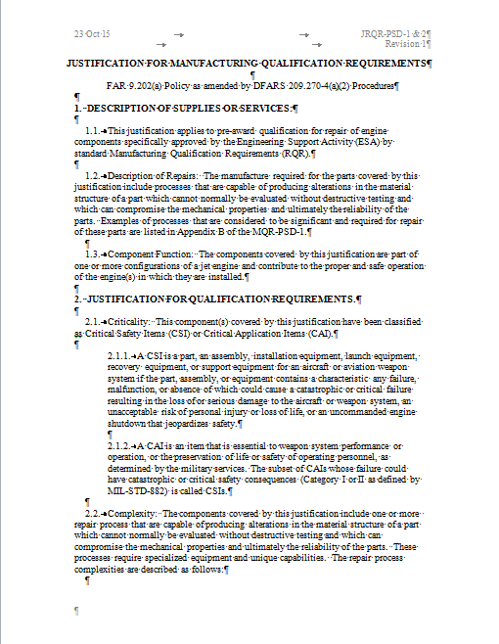
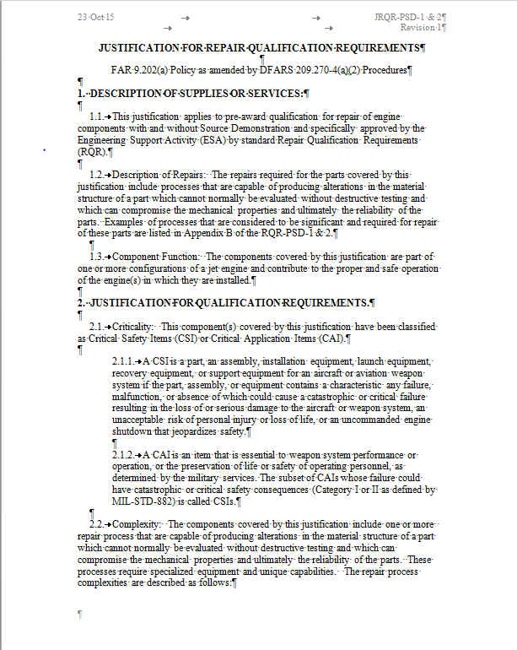
Justification for Qualification Requirements
Engineering
  Check Master QR Listing
  JQR approved August 2015
    CSI
      Technical Branch
    CAI
      Comp Advocate
      Head of Procurement
  Estimated Cost
    Waivers $ 1,500
    SAR/Master SAR $ 2,500
    SAR Lite $ 1,500
    Resubstantiation $ 1,000
    SRR Lite $ 500
https://org.eis.afmc.af.mil/sites/639acsg/LPSE/Source%20Approval%20Request%20Training/Forms/AllItems.aspx

Slide 14
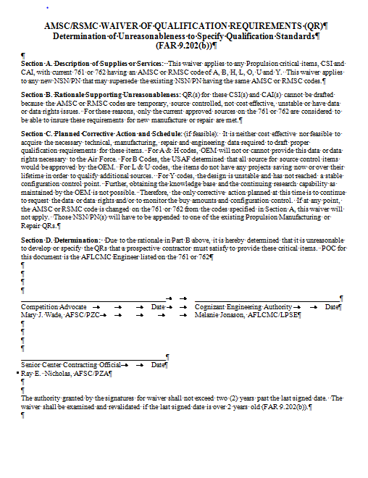
Class Action QR Waiver or Waiver
Waiver issue not to provide Qualification requirements
AMC/AMSC Confirmed
  G (Full and Open Competition)
    No Waiver/SAR Required
  A Data Right Questionable
  B Source Control (OEM Qualification)
  H No sufficient, accurate or legible data to purchase from other then the current source
  L Low Dollar Buy
  O No AMSC Code Assigned
  U No Projected Life Time Savings
  Y Unstable Design
Validate Expiration Date
No Additional Action is Required
Waiver based on AMSC /RMSC Codes
AFMCFARS Part 5309
Still in Work
Notes:
Determination of Unreasonableness to Specify Qualification Standards FAR Part 9.202(b)
I. Description of Supplies or Services:
II. Rationale Supporting Unreasonableness: Include such considerations as extensive design engineering effort to determine exact requirements, extensive research to determine exact requirements, limited Government technical expertise in determining exact requirements, and/or design instability of the part.
III. Planned Corrective Action and Schedule:
IV. Determination: Due to the rationale in Part II above, we hereby determine that it is unreasonable to develop or specify the standards for qualification that a prospective offeror must satisfy for the supplies or services listed in Part I.
__________________________
Cognizant Engineering Authority
__________________________
Competition Advocate
Approval: __________________________
Head of Procuring Activity
Date: __________________________
(Expires 2 years after approval)
(e) For purposes of FAR 9.202(e) and AFFARS 5309.202(e), the HCA redelegates this authority for Other Contracting to the SCCO with power of further redelegation to no lower than one level above the contracting officer.

Slide 15

Waiver means STOP
Waiver Means STOP!!
Do Not Pass Go
Do Not Submit
a SAR

Slide 16
  Acquisition Method Suffix Codes
  AMC/AMSC (RMC/RMSC)
 |  |  | AMC-QR? |  |  |  |  |  | Screen | Screen | ENGR | ES | ENGR | ENGR | ENGR | ENGR | ENGR | ENGR |  | Mar 2015
AMSC | Description | Expire (Months) | 0 | 1 | 2 | 3 | 4 | 5 | TEMP | TDP (Given) | 761 SAW | EDL | JQR | QR Listing | MQR | 84 Waiver | QR Waiver | FAT 260 | Competitive | Notes See DFARS PGI 217.7506
A | Data Right Questionable | 24 |  | No | No | No | No | No | Yes | No | Yes | No | Yes | No | No | No | Yes | No | if 1 or 2 | Limited if alt data source can be used to qualify design control activity (OEM) procedure
B | Source Control | 60 |  | No | No | No | No | No | No | Maybe | Yes | Maybe | Yes | No | No | No | Yes | No | if 1 or 2 | OEM approval. DoD-STD-100. AFI 201-06 shall be considered approved, unless determined by the ESA to be otherwise.
C | Engineering Source Approval | 60 |  | Yes | Yes | Yes | Yes | Yes | No | Yes | Yes | Yes | Yes | Yes | 1.2 | Yes | No | Yes | if 1 or 2 | Approved by CEA per QR
D | GOV Data or Rights NOT Physically Available | 60 |  |  |  | No | No | No | No | No | Yes | No | Yes | No | No | No | Yes | No | if 1 or 2 | can not purchase data or data rights
E | Reserved | Reserved
F | Reserved | Reserved
G | Full and Open Competition | Unlimited |  | No | No | ←Not CSI |  |  |  | Yes | Yes | Yes | No | No | No | No | No | Yes | Yes | Data is available; No restrictions; If FAT is required change to ASMC C
H | No sufficient, accurate or legible data to purchase from other then the current source | 24 |  | No | No | No | No | No | Yes | No | Yes | No | Yes | No | No | No | Yes | No | if 1 or 2
I | Not Authorized |  | Not Authorized
J | Reserved |  | Reserved
K | Approved Class 1 Castings and Similar Forgings SAE- AMS2175 (MIL-STD-2175) | None |  | Yes | Yes | Yes | Yes | Yes | No | Yes | Yes | Yes | Yes | Maybe | Maybe; Depends1,2 | Maybe | Maybe | Yes | if 1 or 2 | one source for casting/forging. Depends if they will provide cast/forge? SAE- AMS2175 (MIL-STD-2175)
L | Low Dollar Buy | O transfer only |  | No | No | No | No | No | Yes | Yes | Yes | Yes | Yes | No | No | No | Yes | No | if 1 or 2 | part buy falls below the screening threshold established by DoD
M | Master Tooling or Coordinated Tooling | 60 | No | Yes | Yes | Yes | Yes | Yes | No | Yes | Yes | Yes | Yes | Maybe | Maybe; Depends1,2 | Maybe | Maybe | Yes | if 1 or 2 | if more then one tooling set exist and can be made available?
N | Manufacturing Requires Special Test a/o Ultra-Precision Quality | 60 | No | No | No | No | No | No | No | Yes | Yes | Yes | Yes | No | No | No | Maybe | No | if 1 or 2 | Can Substantiation and Inspection of the Precision or Quality be Accomplished?
O | No AMSC Code Assigned |  | Yes |  |  |  |  |  | Yes | None
P | Cannot Purchase Data Rights | 60 |  |  |  | No | No | No | No | No | Yes | No | Yes | No | No | No | Yes | No | if 1 or 2 | Uneconomical to Reverse Engineer (RE)? Does second source had the Data?
Q | No Adequate Data, Rights or Both | 24 |  | No | No | No | No | No | Yes | No | Yes | No | Yes | No | No | No | Yes | No | if 1 or 2 | Must be Reviewed Periodically
R | No Data or Rights from Additional Sources | 60 |  | No | No | No | No | No | No | No | Yes | No | Yes | No | No | No | Yes | No | if 1 or 2 | Cannot Purchase data & RE not Economical. Data Rights were not purchased initially (F108)
S | Unclassified Military Sensitive Technology | 60 |  | No | No | No | No | No | No | Controlled | Yes | No | Yes | No | No | No | Yes | No | Controlled; if 1 or 2 | Restricted. No Initial Data Purchased FAR 6.3 Would Require Special Procurement
T | QPL | None |  |  |  |  |  |  |  |  |  |  |  |  |  |  |  |  |  | AFI 20-106 Approved where the ESA coordinated on the approval
U | No Projected Life Time Savings | 60 |  | No | No | No | No | No | No | Yes | Yes | Yes | Yes | No | No | No | Yes | No | if 1 or 2 | Limited to current GOV Sources due to cost of Developing New Sources
V | Formal High Reliability Program | 60 |  | Yes | Yes | Yes | Yes | Yes | No | Yes | Yes | Yes | Yes | No | 3 | No | Yes | No | if 1 or 2 | Designated a High Reliability Part under a Formal Reliability Program. ENSIP or PSIP Programs, SOLAR, DAR or SLAM. OEM and Licensee. Must be on the V-Coded List.
W | Reserved |  | Reserved
X | Not Authorized |  | Not Authorized
Y | Unstable Design | 60 |  | No | No | No | No | No | No | No | Yes | No | Yes | No | No | No | Yes | No | 1 or 2 apply | Limited Quantity for Test or Service Use
Z | Commercial/Non-developmental/off-the-shelf | None |  | No | No | No | No | No | No | No | Yes | No | Yes | No | No | No | Maybe | No | if 1 or 2 | Commercial Manuals Assigned a Technical Manual Number
For the purpose of the QR/SAR ASMC/RMSC Codes: D, N, P, R, S, V* and Z are considered Proprietary
Notes:
DFARSPGI 217.7506 2-203 (a) This acquisition method suffix codes of a temporary nature requiring vigorous follow-through improvement action DFARSPGI 217.7506 2-203 (b) In general, the following codes cannot be improved: 1G, 2G, 1K, 2K, 1M, 2M, 1N, 2N, 1T, 2T, 1Z, or 2Z. Not In Use Qualification requirements apply Temporary. Temporary Not In use for Propulsion

Slide 17
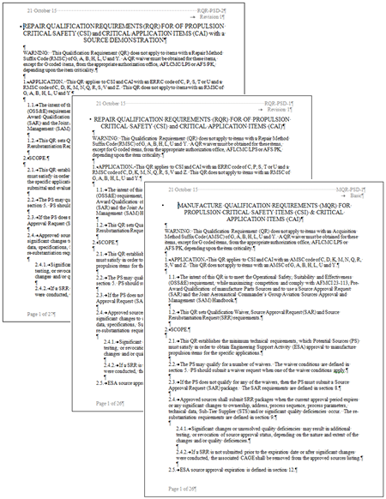
Propulsion Standard QRs
QRs do not apply to AMSC/RMSC codes
  G, A, B, H, L, O, Q, U and Y.
MQR-PSD-1
  Applies to CSI (CAT 1 & 2 ) and
  CAI (CAT 1, 2, & 3)
  AMSC: C, K, and M (Government Rights)
  AMSC : D, N, P, R, S, V and Z (Proprietary)
RQR-PSD-1 or RQR-PSD-2 (Source Demo)
  Applies to CSI (CAT 1 & 2 ) and
  CAI (CAT 1, 2, & 3)
  ERRC: C, P, S, T or U
  RMSC: C, K, and M (Government Rights)
  RMSC : D, N, P, R, S and Z (Proprietary)
Comply with AFMCI 23-113, CSI & SAM Handbooks
Notes:
C Engineering Source Approval
D GOV Data or Rights NOT Physically Available
K Approved Class 1 Castings and Similar Forgings SAE- AMS2175 (MIL-STD-2175)
M Master Tooling or Coordinated Tooling
N Manufacturing Requires Special Test a/o Ultra-Precision Quality
P Cannot Purchase Data Rights
Q No Adequate Data, Rights or Both
R No Data or Rights from Additional Sources
S Unclassified Military Sensitive Technology
V Formal High Reliability Program
Z Commercial/Non-developmental/off-the-shelf

Slide 18
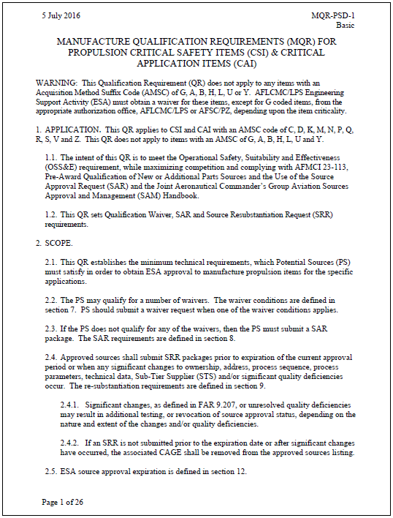
Propulsion Qualification Requirement Outline
Updates incorporated Lessons Learned
Qualification Requirement Content (Section)
  Scope (Section 2)
  Submittal Determination (4)
  Data Acquisition (4.3)
  SAR, Waiver or Re-substantiation Format (5) Waivers and Requirements (7) [20]
  SAR Categories, Format and Requirements (8)
  Source Resubstantiation Request (9)
  Submittals/Point of Entry (10)
  Evaluation (11)
  Expiration (12)
  Self-Assessment & Site Survey Checklist (13).
  Loss of Qualification (14)
Creates Three Types of SARs
  Waivers
  SAR/Master SAR
  SAR lites
Eliminates/Reduces
  Processing Time/Delays
  Overall Manpower Requirements
  SAR Construction Efforts

Slide 19
SAR Waivers
Manufacture(1-7) /Repair(1-8)
The Offeror should consider submitting a waiver for evaluation after they have determined that one of the following waiver conditions has been met:
QWC1: The potential source submits written certification that the articles have been supplied to the government or original equipment manufacturer (e.g., DD Form 250, Material Inspection and Receiving Report, Purchase Order invoice).
QWC2: The potential source is qualified on the right-hand article and requests to be qualified on the left-hand article. If the right-and left-hand articles are mirror images of each other, then approval can generally be given.
QWC3: A source qualified to provide an assembly is usually qualified to provide subassemblies, major components, and items of that assembly. Applies only if all the manufacturing or repair for subcomponents is conducted in-house and elements G, H, K L and M were provided during the qualification of the assembly.
QWC4: A source qualified to provide earlier dash numbers of a basic P/N may be qualified to provide other dash numbers of that same basic P/N, provided there is no increase in complexity, criticality, or other relevant requirements.
QWC5: Supplier shall submit SAR CAT II or III.
QWC6: A source previously qualified to provide an item, but which has been purchased, sold, merged, absorbed, reformed, split, etc., may qualify if it can be established that the qualification is currently with the requester and that the requester has the same or equivalent facilities, tooling, equipment, personnel, and utilizes the original forging, castings, etc., in the process. NOVATION LETTER IS REQUIRED.
QWC7: Other. Needs to be adapted based on the situation. This waiver has been used for OEM moving to a new facility. The ESA will adjust the elements required.
QWC8: Manufacturer. A source qualified to manufacture an item, seeking repair qualification may qualify if it can be established that PS has the same or equivalent facilities, tooling, equipment, data and personnel and utilizes them for the repair of the item.

Slide 20
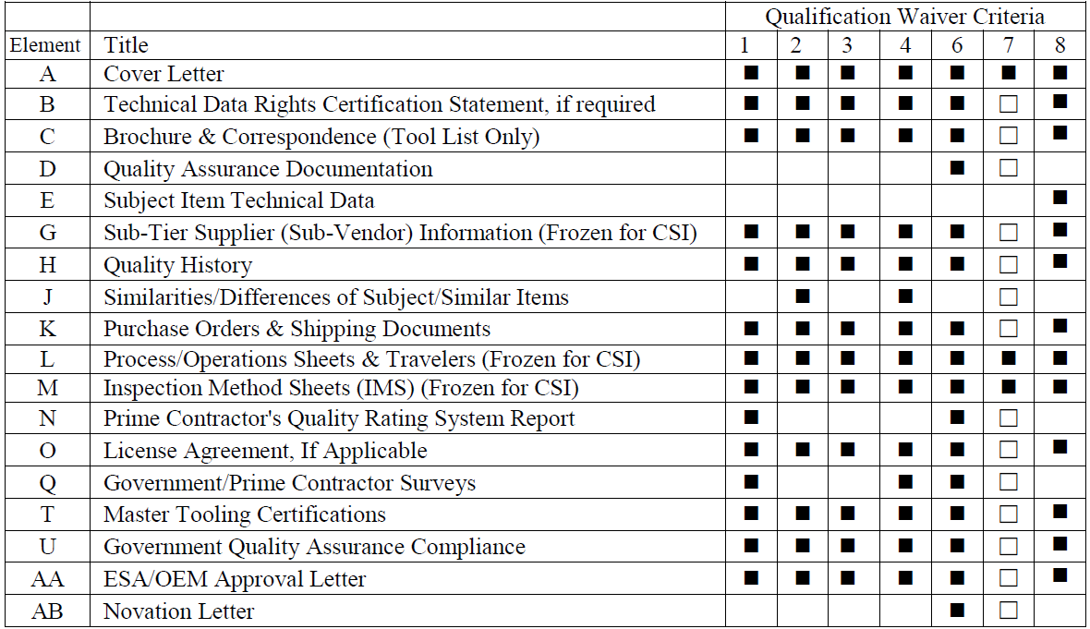
SAR Waiver Data Requirements
Manufacture(1-7) /Repair(1-8)
  Each Waiver must be accompanied with the required data.
  The data requirements are defined by the QR elements
    QWC7 has two Phases. Phase 1 Submit and Seek Approval/Phase 2 Submit Artifact
  The 815 is used to evaluate the data elements.

Slide 21
SAR Waiver Determination
Submitter
  Reviews the QR
  Determines if a Waiver or SAR should be submitted
  Submits the Qualification Waiver Condition (QWC) & Required Artifacts
Use Waiver if one applies versus submitting a SAR.

Slide 22
Technical Data Request
Request Data or Data Rights Purchases for Drawings
Public Sales Office (PSO) (405) 736-4676
  Provides commercial customers a method to purchase engineering data directly from the ALCs data repository.
  Requires the customer to register with FedBizOps prior to a purchase request.
    submit a request for data or ask questions through the PSO email listed below.
  Offers single or revolving account data purchase options.
  Department of Defense policy mandates only the Data Custodian listed on the Military Critical Technical Data Agreement (DD Form 2345) is eligible to receive data.
  NOT Freedom of Information Action (FOIA) or Free
Technical Order Home Office
  Provides commercial customers a method to purchase technical orders directly
  Department of Defense policy mandates only the Data Custodian listed on the Military Critical Technical Data Agreement (DD Form 2345) is eligible to receive data.
  NOT Freedom of Information Action (FOIA) or Free
Prints
T.O.s
Process defined on SASPO Site

Slide 23
AFMCI 23-113 Source Approval Categories
Category I, Actual Item. - SARs received from suppliers who have manufactured or performed ROMM on the exact (Subject) item to the OEM technical data for the prime contractor, OEM, another service or, a civil sector under FAA PMA identicality. The item will be produced and evaluated against the ESA approved technical data package.
Category II, Similar Item. - SARs received from suppliers who have not previously manufactured, repaired, or overhauled the exact (Subject) item, but have manufactured or performed ROMM on items similar in complexity, design, criticality, manufacturing/repair/overhaul processes, materials, and application for the
  a) Prime Contractor, OEM, or another service using OEM data, or
  b) Civil Sector under FAA PMA based on Identicality
Category III, New Manufacturer of Item. - This category covers offerors who do not meet Category I or II criteria but have the OEM’s technical data and intend to produce to the ESA approved technical data package.
Category IV, Alternate Item. - SARs received from an offeror who is proposing an alternate part as the equivalent to the OEM part. These are reverse engineered, but not reengineered components.
Reverse Engineering is a Project not a SAR

Slide 24
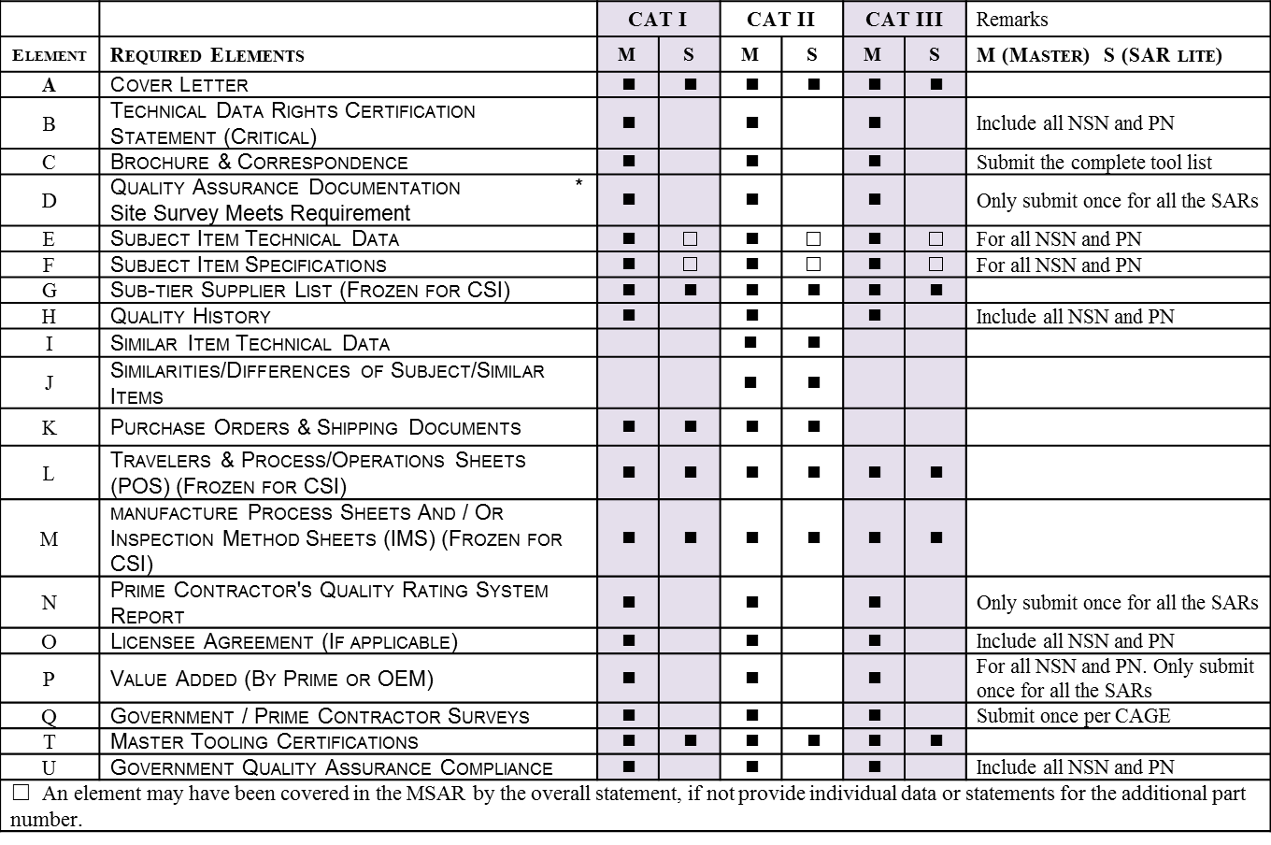
SAR Data Requirements and Format
Each Waiver must be accompanied with the required data based
The data requirements are defined by the QR elements
The 815 is used to evaluate the data elements.
CAT III only applies for Critical Application Items (CAI), Not Critical Safety Items (CSI)

Slide 25
SAR Master & Lite
  Master SAR includes (One):
    Provide Data at the Enterprise Level
    Cover Letter
    Technical Data Rights Statement
      All NSNs on Part-Process Matrix
    Equipment List
    Quality History, if Any
    Licensee Agreements for the Proprietary Data
    Calibration Schedule
  SAR Lite includes (Many):
    Production Documentation for Each NSN
      Travelers, Router or Work Control Document
      Process Operation Sheet
      Inspection Method Sheets

Slide 26
Submittal Determination
Ensure QR has been found
For Help Contact
SBO or SASPO
Begin SAR Construction

Slide 27

SAR Construction and Evaluation
SAR(s), WAIVER(s), OR RE-SUBSTANTIATION (s) packages
3 Ring binder or similar product
  a Table of Contents
  21 A-U element tabs for the MQRs
  21 A-Z element tabs for the RQRs .
  Significantly reduces the ESA evaluation turn time
  Reduces oversight or loss.
Compact Disc (CD) in a .pdf file format.
  single .pdf file with index to each element or a series of folders for each element.
  All CDs should be scanned for viruses prior to inserting them in the GOV computer.
Third, Hybrid.
  Combination of the physical paper and CD with .pdf files.
Source Approval Request package should include
  the qualification requirement call out order.
  Quality Manual and supporting documentation
Submitted to:
  AFSC/SB
  3001 Staff Drive, Ste 1AG85A
  Tinker AFB, OK 73145-3009.
Source Approval Request
The Offeror shall retain copy until the qualification is expired

Slide 28
SAR Review Checklist
LPS Form 815 20160401
(May be adapted to reflect needs)

Slide 29
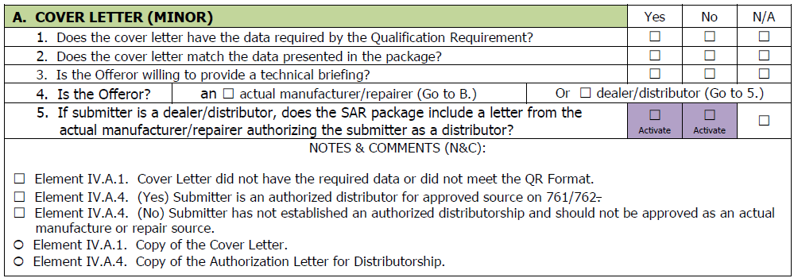
Tab A Cover Letter
All
Provide a cover letter with the following information/data:
  Solicitation No. (if applicable), Contracting Officer POC (if applicable), Engine Type, Company Name, Company CAGE, Address, Company POC, Company Size (Large or Small), QR Identification, Technical Data Proprietary Status, NSNs, PNs, & Nomenclature, Type (Manufacture, Overhaul, Distributor (Manufacture), or Distributor (Overhaul)), SAR Submittal Category, ERRC code (if known), SAR Package Inventory (Binder/Paper, CDs, Electronic or Sample parts) and Disposition.
State that Technical SAR Briefing can be provided upon request.
State if all material submitted can be destroyed or request the return at the offeror’s expense

Slide 30
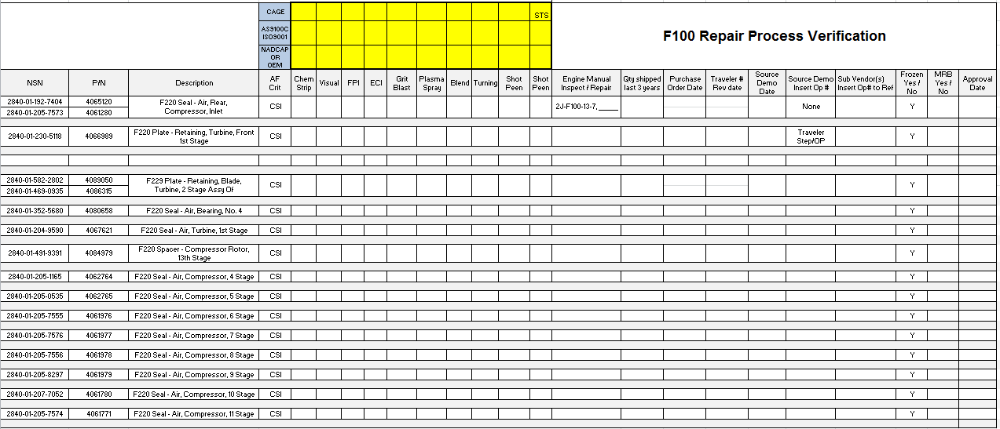
Whole or Assembly Qualification
Part- Process Matrix
2
1
3
4
Part- Process Matrix has 4 steps.
  1 Part-Process Matrix
  2. Process Certification
  3. Production Documentation
  4. ESA Approval
ESA provide the NSN Listing/Initial Matrix

Slide 31
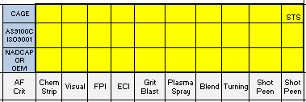
Whole or Assembly Qualification
Part- Process Certification
Enter Data Here for Internal and External Sources
  Provide all the AS 9100 or ISO 9001:2015 expiration dates and NADCAP or OEM certifications/approvals for each significant industrial process used for both internal and external purposes
    CAGE for Whom will be performing that Process
    AS 9100 or ISO 9001 Expiration Date (Include copy of the Certificate)
    Enter the Certification Expiration Date for the Significant Industrial Processes (Include copy of the Certificate)
      If Multiple Sources are to be used then Split the Process to show the Distribution

Slide 32
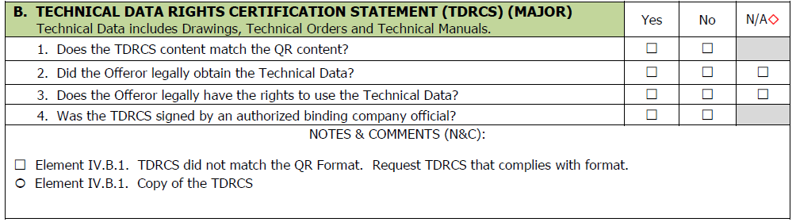
Tab B Technical Data Right Statement
Provide a certification of rights to use technical data in the format provided in Appendix A, signed on company letterhead by an authorized binding company official.
  President or Facility General Manager
The certificate states the data was obtained by legal means and the company has the rights to use the data supplied in the SAR for manufacture/overhaul purposes.
NOTE: This also applies to Government Limited Data
See QR Appendix A
All
No Believe

Slide 33
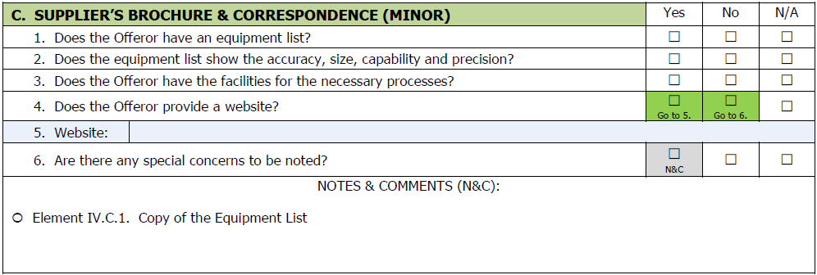
Tab C Company Brochure
  Provide Company Brochure or Website
  Synopsis outlining the applicant’s
    Process Capabilities
    Facilities
      Location
      Number of buildings
      Square Footage
    Experience
  Provide an Equipment List
    Outline Equipment’s Accuracy, Size, Capability and Precision

Slide 34
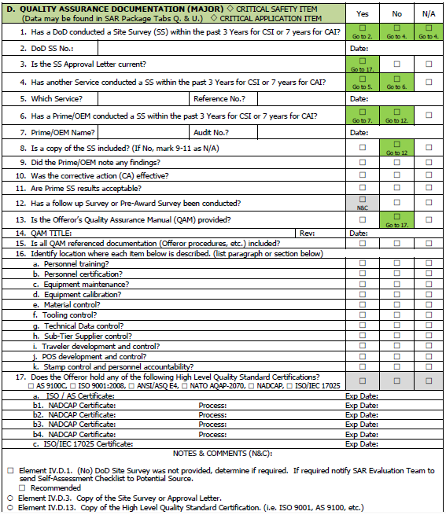
Tab D Quality Assurance
  Provide Certifications
    AS 9100, ISO 9001:2008 , NATO AQAP-2070 or equivalent
    OEM, GOV, or NADCAP significant Industrial Process Certification(s)
    NDI Level III and Other Professional Certification
    See QR Appendix B (slide 37)
  Provide Site Survey (SS), if one was conducted by the DoD in the last 36 months, (No additional documentation required) (SS Example on Slide 68)
    provide a copy of the SS and the Certifications
  Provide Company's Quality Assurance System Manual & all Subordinate Supporting Documentation, if no SS was conducted.
    Data may be retained
  Format: Electronic (PDF) or Paper
Notes:
46.202-1 -- Contracts for Commercial Items.
When acquiring commercial items (see Part 12), the Government shall rely on contractors’ existing quality assurance systems as a substitute for Government inspection and testing before tender for acceptance unless customary market practices for the commercial item being acquired include in-process inspection. Any in-process inspection by the Government shall be conducted in a manner consistent with commercial practice.
46.202-2 -- Government Reliance on Inspection by Contractor.
(a) Except as specified in (b) of this section, the Government shall rely on the contractor to accomplish all inspection and testing needed to ensure that supplies or services acquired at or below the simplified acquisition threshold conform to contract quality requirements before they are tendered to the Government (see 46.301).
(b) The Government shall not rely on inspection by the contractor if the contracting officer determines that the Government has a need to test the supplies or services in advance of their tender for acceptance, or to pass judgment upon the adequacy of the contractor’s internal work processes. In making the determination, the contracting officer shall consider--
(1) The nature of the supplies and services being purchased and their intended use;
(2) The potential losses in the event of defects;
(3) The likelihood of uncontested replacement or correction of defective work; and
(4) The cost of detailed Government inspection.
46.202-3 -- Standard Inspection Requirements.
(a) Standard inspection requirements are contained in the clauses prescribed in 46.302 through 46.308, and in the product and service specifications that are included in solicitations and contracts.
(b) The clauses referred to in (a) of this section--
(1) Require the contractor to provide and maintain an inspection system that is acceptable to the Government;
(2) Give the Government the right to make inspections and tests while work is in process; and
(3) Require the contractor to keep complete, and make available to the Government, records of its inspection work.
46.202-4 -- Higher-Level Contract Quality Requirements.
(a) Agencies shall establish procedures for determining when higher-level contract quality requirements are necessary, for determining the risk (both the likelihood and the impact) of nonconformance, and for advising the contracting officer about which higher-level standards should be applied and included in the solicitation and contract. Requiring compliance with higher-level quality standards is necessary in solicitations and contracts for complex or critical items (see 46.203) or when the technical requirements of the contract require --
(1) Control of such things as design, work operations, in-process controls, testing, and inspection; or
(2) Attention to such factors as organization, planning, work instructions, documentation control, and advanced metrology.
(b) Examples of higher-level quality standards include overarching quality management system standards such as ISO 9001, ASQ/ANSI E4; ASME NQA-1, SAE AS9100, SAE AS9003, and ISO/TS 16949, and product or process specific quality standards such as SAE AS5553.

Slide 35
FAR 46.202-4 -- Higher-Level Contract Quality Requirements
(a) Agencies shall establish procedures for determining when higher-level contract quality requirements are necessary, for determining the risk (both the likelihood and the impact) of nonconformance, and for advising the contracting officer about which higher-level standards should be applied and included in the solicitation and contract. Requiring compliance with higher-level quality standards is necessary in solicitations and contracts for complex or critical items (see 46.203) or when the technical requirements of the contract require --
(1) Control of such things as design, work operations, in-process controls, testing, and inspection; or
(2) Attention to such factors as organization, planning, work instructions, documentation control, and advanced metrology.
(b) Examples of higher-level quality standards include overarching quality management system standards such as ISO 9001, ASQ/ANSI E4; ASME NQA-1, SAE AS9100, SAE AS9003, and ISO/TS 16949, and product or process specific quality standards such as SAE AS5553.

Slide 36
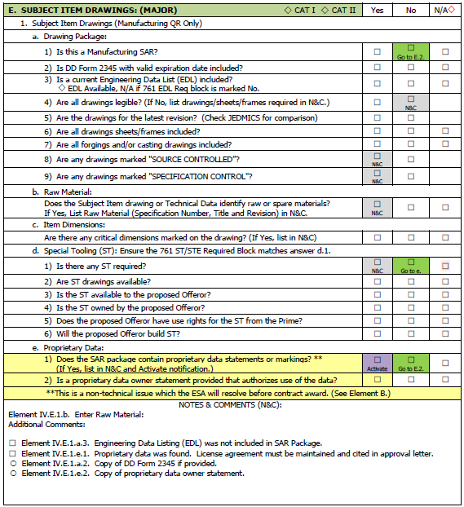
Tab E Subject Drawings/Tech Data
Part 1: Manufacturing
Provide a DD Form 2345
For Government Provided Technical Data
  Provide a Technical Data List (EDL)
  Provide all Drawings (Complete and Readable) (First Page of Gov. Provided Documents)
    Inspection and Inspection Intervals
    Manufacture or Alternate (if applicable)
    Must cover the Measurement Units
    Assemble and Test (if applicable)
  or Copy of the Sales Receipt detailing purchase
  For Proprietary Technical Data.
  If proprietary data can be submitted, provide EDL and the latest legible revision of all technical data
  If proprietary data cannot be provided,
    submit licensing agreement or ownership statement
    a statement declaring that the data cannot be submitted and that the licensing agreement or ownership statement ensures the most current data will be used to perform the required work,
    a copy of the title page.
      The images may be redacted to only reveal the technical data number, title, revision and proprietary statement.
  Provide a Special Tooling Statement
Notes:
Department of Defense policy mandates only the Data Custodian listed on the Military Critical Technical Data Agreement (DD Form 2345) is eligible to receive data. Drawings (Complete and Readable) (First Page of the Government Provided Documents)
Engineering Data List (EDL)
Repair Data List (RDL)

Slide 37
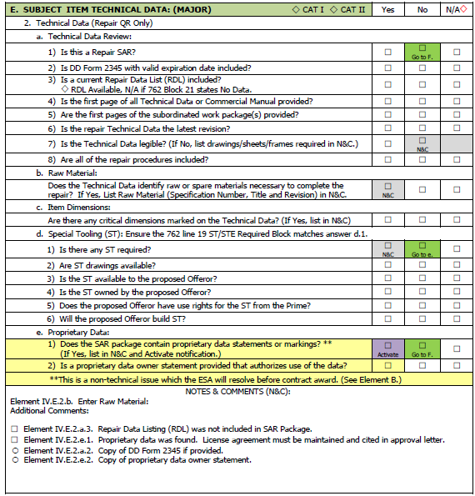
Tab E Subject Drawings/Tech Data
Part 2: Repair
Provide a DD Form 2345
  For Government Provided Technical Data
  Provide a Technical Data List (RDL)
  Provide all Technical Orders (Complete and Readable)
  First Page of the Gov. Provided Documents
    Inspection and Inspection Intervals
    Repair or Alternate (if applicable)
    Must cover the Measurement Units
    Assemble and Test (if applicable)
  or Copy of the Sales Receipt detailing purchase
  For Proprietary Technical Data.
  If proprietary data can be submitted, provide RDL and the latest legible revision of all technical data
  If proprietary data cannot be provided,
    submit licensing agreement or ownership statement
    a statement declaring that the data cannot be submitted and that the licensing agreement or ownership statement ensures the most current data will be used to perform the required work,
    a copy of the title page.
      The images may be redacted to only reveal the technical data number, title, revision and proprietary statement.
  Provide a Special Tooling Statement

Slide 38
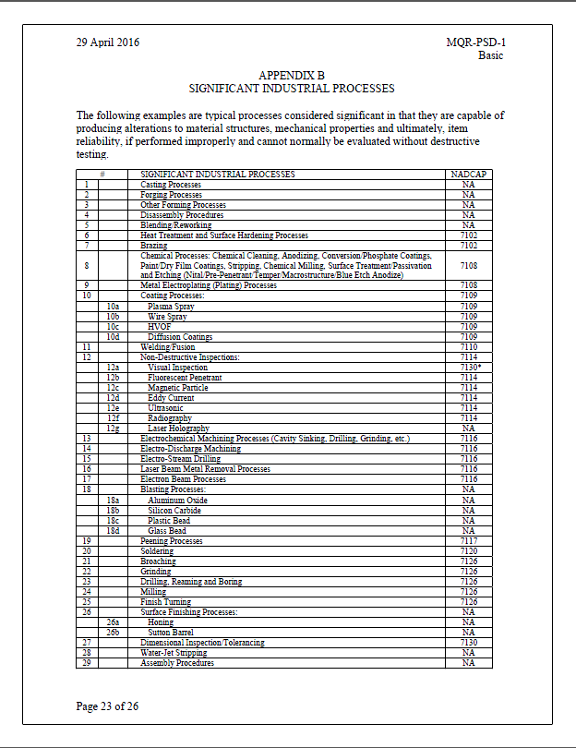
Significant Industrial Processes
QR Appendix B
  Certifications
    Significant Industrial Process Certification(s)
      OEM,
      GOV for the Process not Parts,
      NADCAP
    NDI Level III
      Other Professional Certification
46.202-4 -- Higher-Level Contract Quality Requirements.
(a) Agencies shall establish procedures for determining when higher-level contract quality requirements are necessary, for determining the risk (both the likelihood and the impact) of nonconformance, and for advising the contracting officer about which higher-level standards should be applied and included in the solicitation and contract. Requiring compliance with higher-level quality standards is necessary in solicitations and contracts for complex or critical items (see 46.203) or when the technical requirements of the contract require --
(1) Control of such things as design, work operations, in-process controls, testing, and inspection; or
(2) Attention to such factors as organization, planning, work instructions, documentation control, and advanced metrology.
(b) Examples of higher-level quality standards include overarching quality management system standards such as ISO 9001, ASQ/ANSI E4; ASME NQA-1, SAE AS9100, SAE AS9003, and ISO/TS 16949, and product or process specific quality standards such as SAE AS5553.

Slide 39
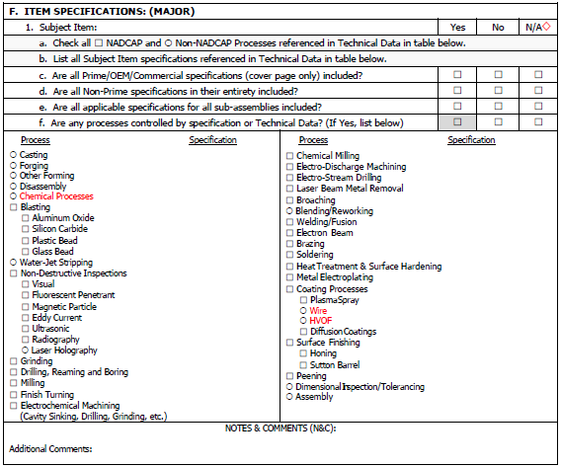
Tab F Specifications
  For CAT I & III (Subject), provide a complete list of the applicable specifications identified on the subject item manufacture technical data and a copy of the title page of the latest revision of each specification.
  Provide Applicable Specifications Listing (Readable First Page)
    Identified on the subject item technical data or drawings
    Copy of the title page of the latest revision
  For CAT II, (Similar)
  Applicable Specifications Listing (Readable First Page)
    Identified on the similar item technical data or drawings
    Copy of the title page of the latest revision
  For Internal Specifications (Entire Copy)
Data Rules from Element E Apply

Slide 40
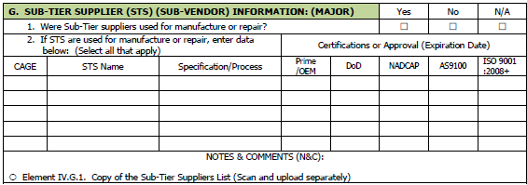
Tab G Sub-Tier Supplier (STS)
If No Sub-Tier suppliers are used, then provide a statement that all work is performed in house. (Question 1)
Sub-Tier Suppliers provide the Matrix below
    Provide a copy of STS’s AS 9100, ISO 9001:2008 , NATO AQAP-2070 or equivalent certificate
  Raw material (castings and forgings)
    Currently approved by the OEM or ESA or
    Provide a rationale proving to the ESA that the casting or forging source is capable of manufacturing the replacement part to the equivalent or better to OEM or ESA quality standards
  Significant Processes Listed in Appendix B (Slide 37)
    Denoted as critical or non-critical
    Names and addresses
    State OEM, NADCAP or DoD approved, if required
      Submit official OEM, NADCAP or DoD significant industrial process certification
  Non-OEM or government whole part manufacturer/repair STS
      Submit complete SAR Package for the repair source
  Assembly (Government Approval Required)
  For STS providing proprietary industrial process support, provide a letter of support, capability and an expiration date.
Notes:
DLA Logistics Information Services
Joint Certification Program
http://www.dlis.dla.mil/jcp/#
(877) 352-2255
For the 2345s.
http://www.dtic.mil/whs/directives/infomgt/forms/eforms/dd2345.pdf

Slide 41
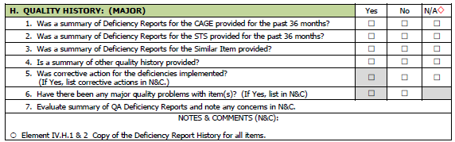
Tab H Quality History
  State if there is no quality history, else
  Provide a summary of all deficiency experienced & MRB actions for past 36 months for all items
    P/N, Noun, Feature, Deficiency, Quantity, Date & Corrective Action History
  Provide a summary of (including but not limited to) internal deficiencies, commercial deficiencies, FAA Service Bulletins, MRB items, Quality Reports & scrap rates
  Provide STS’s Deficiency Report Summary for the ALL items for the past 36 months
  Provide STS CAR, CAP and implementation schedules when applicable, on previous contracts
Provide all CARs & CAPs for Major Events
Notes:
CAR Corrective Action Request
CAP Corrective Action Plans

Slide 42
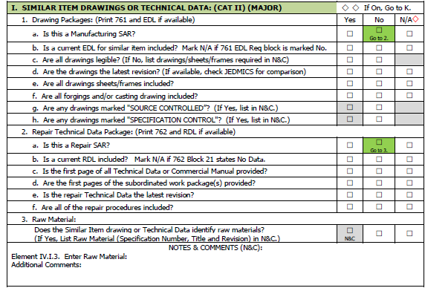
Tab I Similar Tech Data & Drawings
For Category II SARs Only
  (Same requirement as Element E, but for the Similar part Number(s)
    Provide all technical data or drawings required
      Inspect and inspection intervals
      Manufacture or Repair
      Assembly
      Test

Slide 43
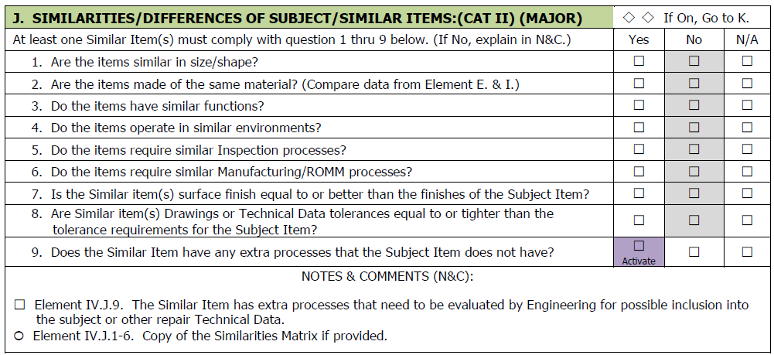
Tab J Comparison Chart
For Category II SARs Only
  Provide Comparison Charts
      Materials (Specification & Coatings)
      Design (Size & Dimensional Tolerancing)
      Industrial Processes and
      Operating Environment
  The preferred method is a comparison matrix
Material, Process, Features and Tolerance

Slide 44
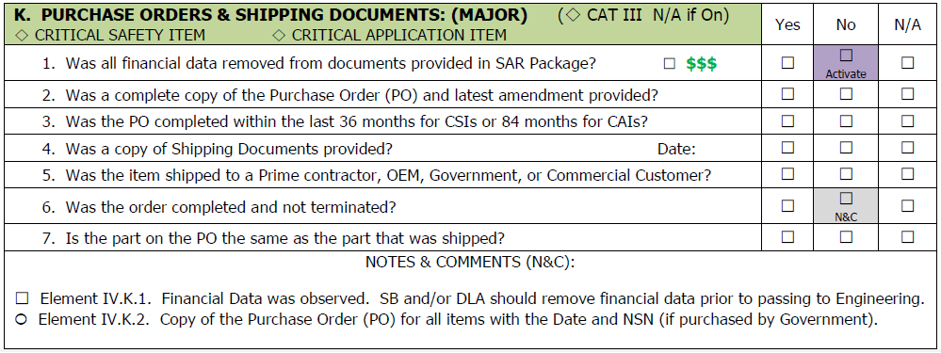
    Tab K Purchase Order & Shipping
    Same as Element L and M
  If the product or repair has never been provided, state it
  Provide at least one purchase order (PO)
    Within 36 months for CSI and 84 months for CAI for item(s) submitted
    Remove financial $$ information and Circle dates
    Provide any contract amendments from the commercial customer(s) (CC)
    Cat I or II, Provide PO from the Prime, OEM, Gov’t, Foreign Gov’t, or CC
    Cat III, provide at least one PO & Shipping documents (if applicable)
      If you have never provided the item or the repair to any customer, identify this in the SAR package.
      Commercial customers or OEM sales Shipping documents should account for all contracted items
    If a contract was terminated, state the termination reason(s)
    The PO should match the part number in the contract(s) list in Element L and M

Slide 45
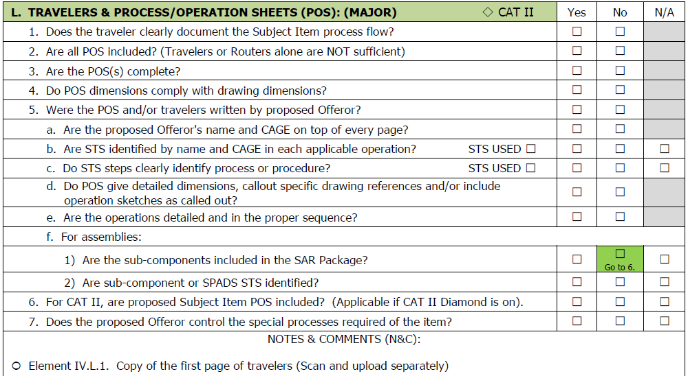
    Tab L Travelers & Process Operation Sheets(POS)
    Same as Element K and M
Provide Actual Supplier’s complete detailed step-by-step procedural account (Travelers)
  NAME and CAGE on Top of Each Page
  For All Part Numbers Processes
  Proper processing sequence
  Operation No., description, tolerance (specification), location, STSs, software data file name, etc.
  Requiring in-process operator or inspector buy off and documentation of the actual measures
Provide detailed proposed/actual op sheets for Traveler(s) process that require them
Frozen for All CSI

Slide 46
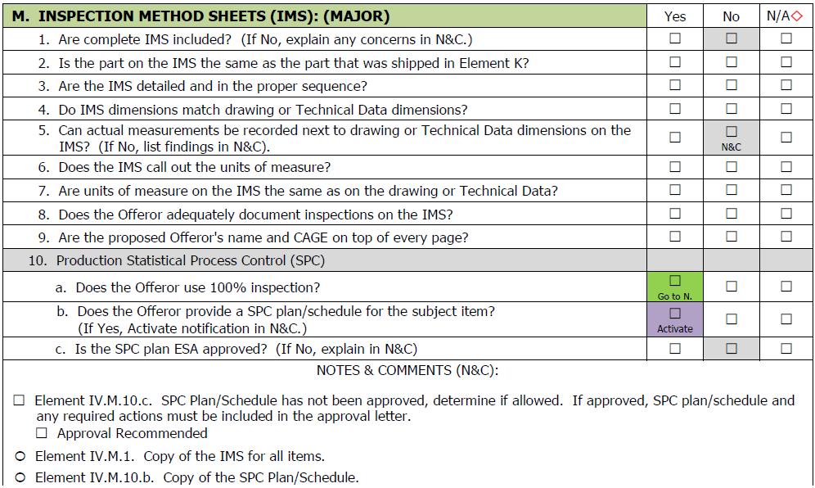
Tab M Repair Process Sheet (RPS) &
Inspection Method Sheets (IMS)
  Provide the RPS & IMS for all parts submitted
    Nomenclature, part number, characteristics inspected, special instructions, zone, tolerances and actual measurements, inspection tooling/method, frequency and inspector's stamp
  Category II, provide the completed RPS and IMS with the data for the similar item(s).
  RPS and IMS may be included as an integral part of the POS/OP sheets in Element L
  The data for the same items provided in SAR Elements K & L
Frozen for All CSI

Slide 47
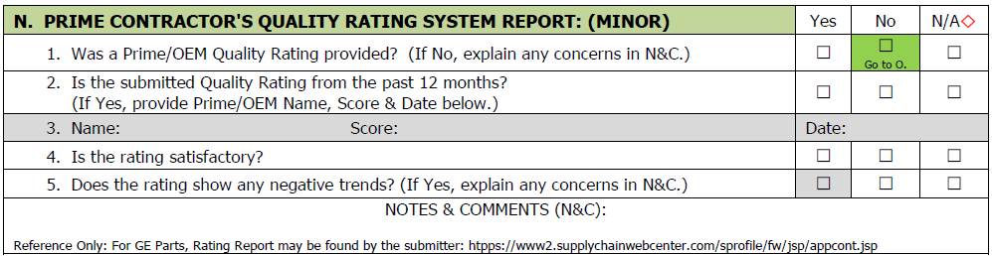
Tab N Quality Rating System Report
  If no quality rating is available, state as such
  If no rating from the subject part prime contractor/OEM is available, alternate quality ratings from another prime contractor and/or OEM should be submitted.
  Provide the proposing offeror's prime contractor or OEM quality system report or rating for the item submitted

Slide 48
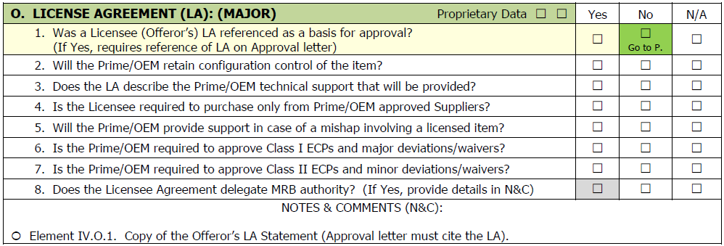
Tab O Licensee Agreement
Applies to ASMC/RMSC Codes: D, N, P, R, S, V* and Z
Provide the Licensee Agreement (LA), if required
  Supplier should ensure the LA allows for the data to be used for SAR submittal
  Provide copy of LA between the proposed contractor and data rights holder for all parts affected
  If a copy of LA cannot be provided, provide a statement summarizing the LA and if it is required to perform the processes
    At a minimum provide, a redacted portion of LA showing the details of MRB activity, data rights, configuration control, and source control.
For Proprietary Data Only

Slide 49
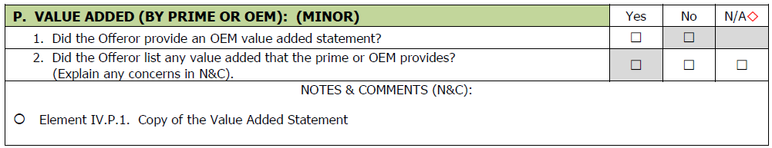
Tab P Prime/OEM Value Added
  Provide Statement Identifying any value added provided by the Prime/OEM for item(s)
  Value added is considered any action, manufacture/repair or inspection process, data, instructions, or equipment that is essential to the manufacture/repair of the item, but is not documented in the data package
    Sub-Tier suppliers qualification of significant industrial processes for an item should be listed
What’s the OEM Input or Contribution?

Slide 50
Tab Q Gov’t/Prime Site Surveys
  If no site survey was conducted, state as such
  Provide a copy of the latest Site Survey, Audit report or Acceptance Letter for the past seven years
    Performed by a DoD, OEM or NADCAP
    Survey Report (survey, findings, and corrective actions)
    Technical evaluations of the offeror's capability, quality assurance procedures, industrial resources, material purchasing, and Sub-Tier supplier controls
Evaluated in Element D

Slide 51
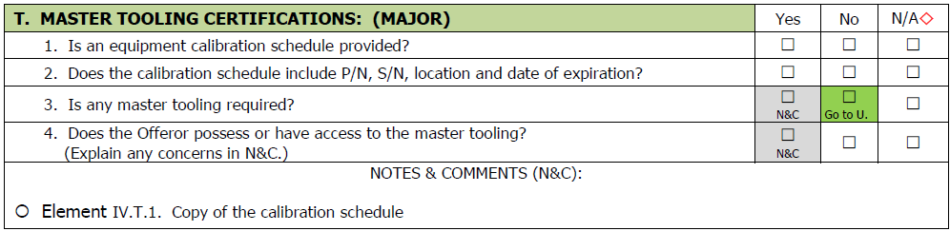
Tab T Master Tooling Certification
  State if no master tooling or calibration is required
  Provide certification of access to and the right to use any required master tooling, special tooling/test equipment, Mylars (stable base drawings), glass layout and loft data/contour data required
  Provide proof of calibration for all equipment/tooling requiring it
Calibration (All) & Master Tooling (AMSC M Mostly)

Slide 52
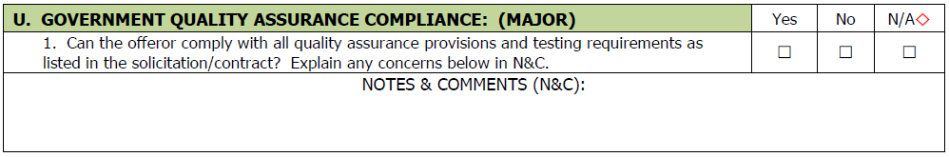
Tab U Govt Quality Assurance Compliance
  Provide a statement that the offeror will comply
    With all government imposed quality assurance provisions for the subject item
    Testing requirements, etc. as identified in the solicitation or contract
Combined with Tab D

Slide 53
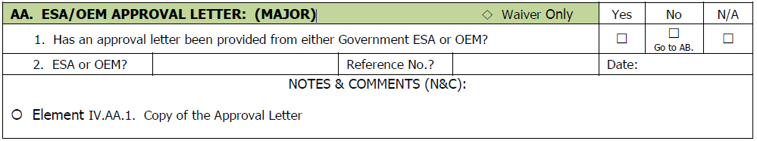
Tab AA ESA/OEM APPROVAL LETTER
Provide a copy of the ESA/OEM approval letter or certificate with the expiration or issuance date circled.

Slide 54
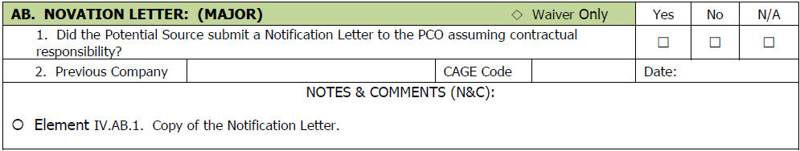
Tab AB Novation Letter
Provide a copy of the novation letter submitted to the PCO for the given NSN.
Notes:
Novation agreement” means a legal instrument--
(1) Executed by the--
(i) Contractor (transferor);
(ii) Successor in interest (transferee); and
(iii) Government; and
(2) By which, among other things, the transferor guarantees performance of the contract, the transferee assumes all obligations under the contract, and the Government recognizes the transfer of the contract and related assets.

Slide 55
Pre-Submittal SAR Audit
Conduct a Pre-Submittal Self Audit prior to submitting the SAR
  Ensure the QR has been posted or provide by the DOD and was used to create the SAR
  Ensure the required elements contain the required documents
  Ensure the quality of the documents
    If errors are present provide the Corrective Action Taken
  Ensure Data Rights have been Reviewed
  Ensure SAR was created to the QR, not AFMCI 23-113.
  Check the SAR Completeness and Order.
Submit SAR

Slide 56
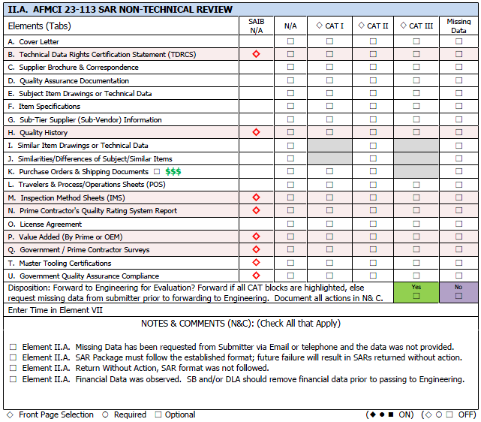
  Non-Technical SAR Review
LPS 815 Element 2
Small Business Office (SBO) or Strategic Alternate Source Program Office (SASPO)
  Ensures QR has been issued
  Conducts NTR (Inventory Control)
  Ensures that all required data is present (Quantitative)
  Requests Missing data
  ✵ Front Page Selection ○ Required ☐ Optional

Slide 57
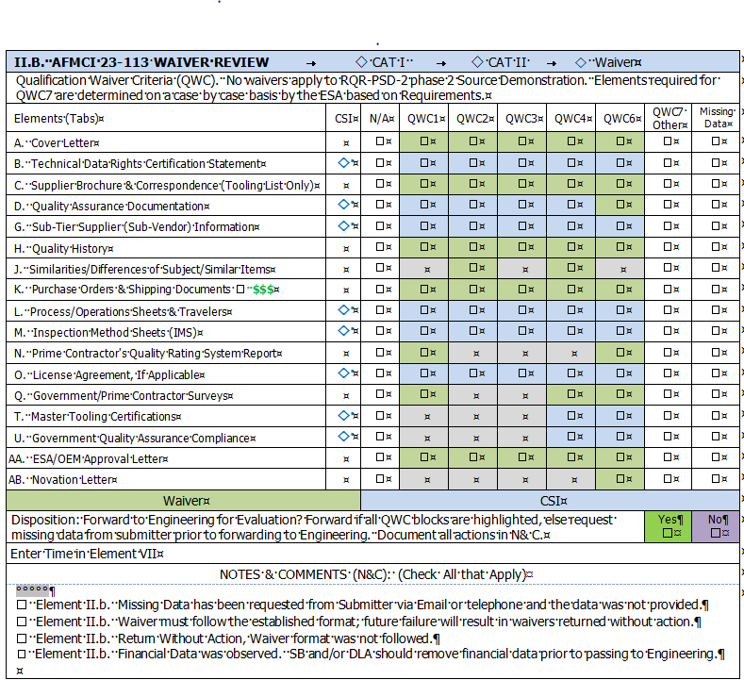
  Non-Technical Waiver Review
LPS 815 Element 2
Small Business Office or Strategic Alternate Source Program Office
  Ensures QR has been issued
  Conducts NTR (Inventory Control)
  Ensures that all required data is present (Quantitative)
  Requests Missing data
  Returns Package to Submitter or Forwards to Engineering

Slide 58
SAR Evaluation
LPS 815 Element 4
Guidance:
  AFI 20-106
  AFMCI 23-113
  LPS OI 23-113
  AFLCMC/LPS Form 815
Based on AFMCI 23-113
QR Determination
Tailor LPS Form 815 to the QR
Evaluation Elements 4
  Tabs A-Z
  Collect and Document Artifacts
  Summary & Recommendations
    Government Contract Engineers conduct the evaluations, if available, for the ESA .

Slide 59
Missing Data Request
  Engineering
  Completes SAR Evaluation
  For Missing Data:
    Complete List of all Elements
    Sent to Submitter
    72 Hours to Reply
      Provide the Data Requested
      Provide A Firm Date
        (No Extensions will be Given)
Provide Response within 72 Hours

Slide 60
Disposition Letters
  Engineering (ESA) reviews the 815 and ensures QR elements and artifacts have been complied with.
  Disapproval Letter
    All Missing data
    All Deficiencies
    And Returns the SAR along with the Disapproval Letter
  Approval Letter
    Lists any restrictions:
      Licensing agreements
      Statistical Control Plans
  Return without Action Letter
    Waiver was issued and SAR are blocked up to two years
    No QR issued
    SAR does not follow QR
    Submitter must resubmit
    Missing Data and Discrepancies were not Corrected
  If Approved, Adds new sources to the Approval Source List, 761 or 762
  Expiration Date will be Defined

Slide 61
Distributors/Dealers
Three Categories:
  New Distributor with Approved Sources
    Require a Designation Letter from the Source
    Require the ESA Approval Letter for the Source
  New Distributor or Production Acceptance Holder (PAH) With New Source
    Require a Designation Letter from the Source
    Require the Complete SAR with the Source Data per the ESA Qualification Requirement
  New Distributor or Production Acceptance Holder (PAH) submitting as the manufacture or repair source
    Required the ESA to make a Distributor determination.
    Return the SAR without action and with the following Recommendations
      Submit a Designation Letter from the Source
      Submit the Complete SAR with the Source Data per the ESA Qualification Requirement

Slide 62
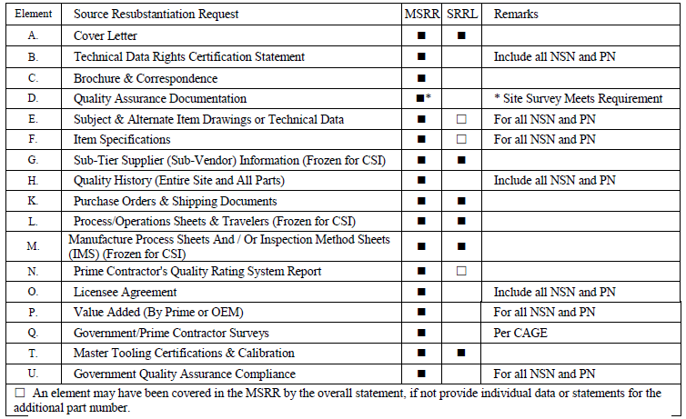
Source Resubstantiation Request (SRR)
  CSI every 3 Years
  CAI every 7 Years
  Assembly SAR Packages
    Master
    SAR Lite Packages
    Submitted Within 30 Days
  Artifacts Submitted
  Prime & OEM
    Removed per AFI 20-106
    Should not be removed based time limits.
To Resubstantiate, CAGE must have produced Subject Item within the Approval Period, else a SAR CAT II or Waiver must be submitted.

Slide 63
LPS Form 810 20150320
Self-Assessment or Site Survey Checklist
(May be adapted to reflect needs)

Slide 64
Self-Assessment (SA) Checklist
Comprehensive review of the Quality Management System and all supporting documents
  15 Page Checklist
Three phase Process
  Submittal
  Review & Resubmittal
  CAR & CAR Management
ESA Recommendation for Site Survey
Same Checklist is used for Site Survey
Based on the ASAM Checklist

Slide 65
Site Survey (SS) Determination
ESA Determination
  Self-Assessment without Site Survey Approval
    Email/Mail
    Self Corrections are Reviewed
    No additional Action Required
  Site Survey 1-Day Review (Plant Verification)
    2 Person Site Visit
    Overall Operation Review
  Site Survey 3-Day Review (Full/36 Hours)
    2 Person Site Visit
    Full Self-Assessment Checklist Validation
Based on Self Assessment Results & DoD Search

Slide 66
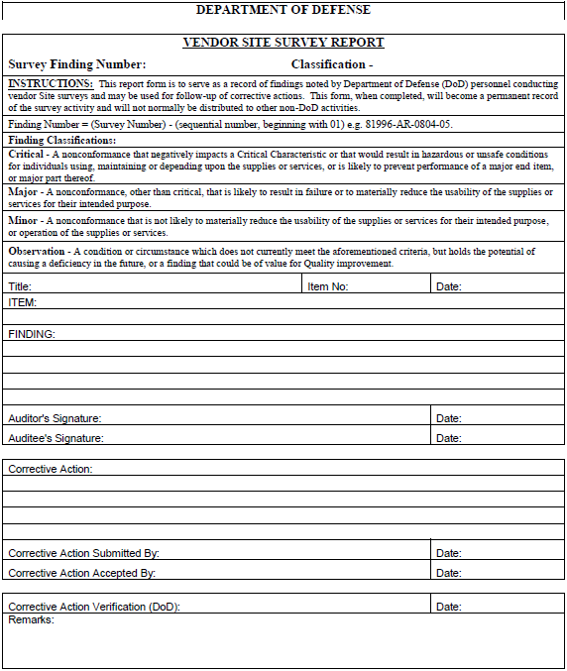
Corrective Action Request (CAR)
Engineering
  Completes Self-Assessment
  3 Phase Process
    Submit
    Evaluate
    Track
  Timeline must be monitored and maintained
    Submitter must stay on implementation schedule
  Site Survey may still be required

Slide 67
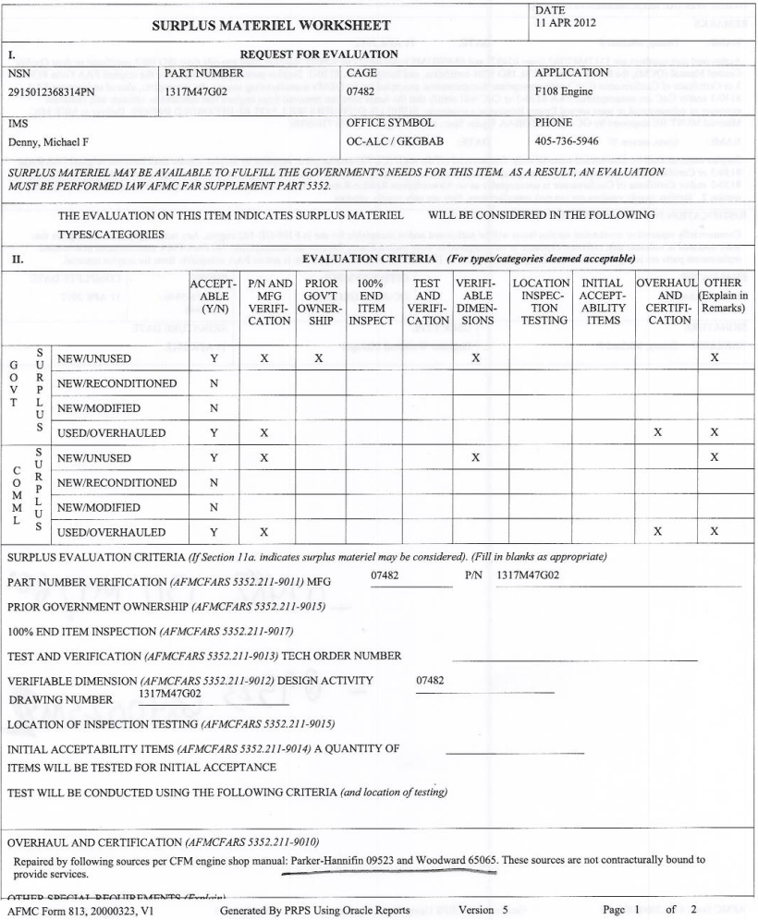
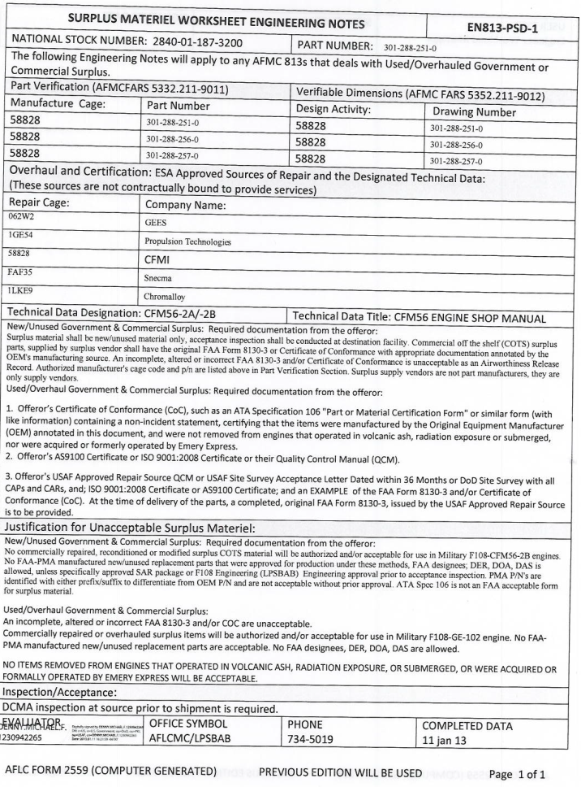
Commercial Used/ Overhauled (C-U/O)Buys
ESA determines NSN Candidacy
  F108, TF33, T56, T34 & F117
  Part Numbers
  Manufacturing Sources
  Repair Sources
  Technical Requirements
Engines | Approved Repair Source | Seeking Repair Sources
F108 | $ 171,948,713 | $38,921,017
T56 | $ 21,259,357 | $6,229,893
TF34 | $ - | $13,985,087
TF33 | $ 22,965,312 | $77,469,455
J85 | $ 14,254,512 | $28,887,601
T700 | $ - | $ 336,0000
 | $ 230,427,894 | $165,829,053
C-U/O PowerPoint Slides on SASPO Site
Notes:
Seeking C-U/O Proposal & Repair Source Packages for the Bucket 1 & 2 NSNs
Find the FBO Announcement and Submit
Find the Established Qualification Requirements & Construct Complete SARs
All items are Propulsion items and are managed at Tinker AFB

Slide 68
Frozen Traveler Update
All CSI Production Documentation is Frozen after approval or FAT acceptance, which is last.
If Supplier requires the Production Documentation to be updated after approval, then must submit an update request including changes and supporting documentation:
  New Production Documentation
  STS List
  Copy of the Front Pages of the Data that drove the Change
  Approval Letter
The Changes shall not be implemented unless ESA or PCO provide approval.
Submit Changes to SBO
ESA will review and provide determination and update approval letter to reflect the new traveler update

Slide 69
Summary
Seek QR or QR Waiver
Understand the QR
Prepare SAR and Artifacts
Conduct SAR Self Audit
Submit SAR to SBO
If Required, Submit Missing Data
If Approved, Track Approval until Expired

Slide 70
Questions?

