Slide 1
Source Approval Request (SAR) and Qualification Requirements Industry Training
SASPO Industry Day
DISTRIBUTION A Approved for Public Release; Distribution Unlimited. Destruction: 100% Shred
SAR Team
AFLCMC/LPE (Propulsion Engineering)
Email: AFLCMC.LPE.SourceEvalTeam@us.af.mil

Slide 2
BLUF
USAF WANTS to qualify YOU to manufacture and repair our parts !!!
  Increases competition and reduces sustainment costs
  Minimize qualification requirements while maintaining OSS&E (Operational Safety Suitability and Effectiveness)
USAF Seeking Focused SARs
  If we don’t need the parts, you won’t get a contract!

Slide 3
Overview
MQR/RQR
SAR Categories
Company Profiles
SAR Elements
Self-Assessment Checklist
Significant Industrial Process List
Cover Letter
Repair Capability/Source of Supply Matrix for Modules & Assemblies
Technical Data Rights Statement
Similar Item Comparison
Re-substantiation/Process Change Request
Operational Changes (for approved sources)
Finding Tech Data
Document Submittal

Slide 4
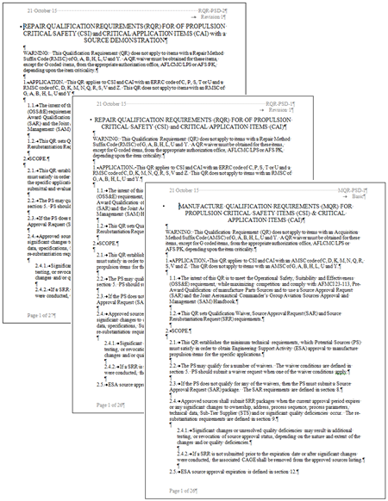
Propulsion Standard QRs
Find the QRs at the SASPO website:
- http://www.tinker.af.mil/Home/429SCMS-SASPO/
MQR-PSD-1
  Applies to CAT 1 & 2
RQR-PSD-1
  Applies to CAT 1, 2, 4, & 5
Comply with AFMCI 23-113, AFMCI 21-112, & SAM Handbooks

Slide 5
Source Approval Categories
Category I, Actual Item. - 8.1.1.1. This category covers PS who repair the exact subject item, using OEM technical data, for the prime contractor, OEM, DOD, civil agency, foreign government, or the civil sector under Federal Aviation Administration (FAA).
Category II, Similar Item. - 8.1.2.1. This category covers PS who have not previously repaired the exact subject item, but have repaired other items similar in material, coatings, design features, industrial processes, etc. for the prime contractor, OEM, DOD, civil agency, foreign government, or the civil sector under FAA. Multiple similar items may be used to demonstrate relevant experience. Similarity is not limited to aerospace applications.

Slide 6
Source Approval Categories
For Repair Only (RQR-PSD-1)
Category IV, Pre-Developed Repair. - This category covers unsolicited SAR submittals by PSs who have a previously developed repair that has: been fully validated and verified, successfully performed on regular production parts, and those parts that have undergone the repair have had sufficient operational experience, including either AMT (Accelerated Mission Testing) or field operational use. This category will require all elements of a SAR Package and any additional information as determined by the ESA.
Category V, Developing Repair. - This category covers the PSs who have a repair, or could develop a repair, that will satisfy the need of the USAF in accordance with an advertised requirement. PS approval of a Category V SAR may still require repair verification, validation, and testing prior to complete approval of PS as an approved source. This category will require all elements of a SAR Package and any additional information as determined by the ESA.

Slide 7
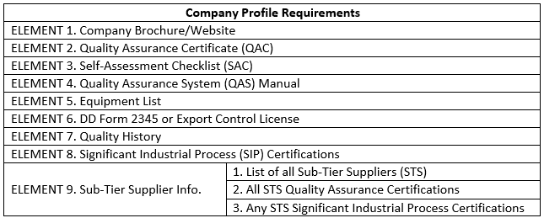
Company Profile Requirements and Format
Each Company Profile must include the required data
The data requirements are defined by the QR elements
The 1221 is used to evaluate the data elements

Slide 8
Company Profile Elements
Element 1: Company Brochure/Website
Element 2: Quality Assurance Certificate
  ISO 9001, AS9100, AS9110, or NATO-AQAP-2070
Element 3: Self-Assessment Checklist (see Appendix A)
Element 4: Quality Assurance System (QAS) Manual
Element 5: Equipment List
Element 6: DD Form 2345 or Export Control License
Element 7: Quality History

Slide 9
Company Profile Elements
Element 8: Significant Industrial Process Certification
    Methods of certification include, but are not limited to, NADCAP, OEM, DOD (Air Force, DCMA, Navy, or Army certification and/or audit), or other external audit
    All methods will be reviewed by the ESA for process control and acceptability

Slide 10
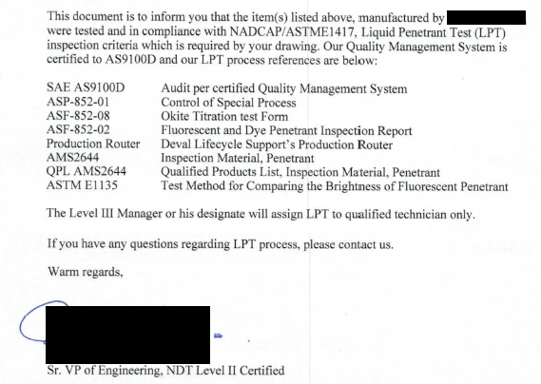
Company Profile Elements
Element 8: Significant Industrial Process Certification (cont.)
  Example:
    Signed Process Letter
    Actual Certs (as identified)

Slide 11
Company Profile Elements
Element 9: Sub-Tier Supplier Info.
  List of all Sub-Tier Suppliers (STS)
  All STS Quality Assurance Certifications
  Any STS Significant Industrial Process Certifications

Slide 12
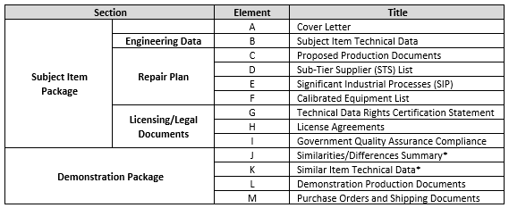
SAR Data Requirements and Format
Each SAR must be accompanied with the required data
The data requirements are defined by the QR elements
The 815 is used to evaluate the data elements

Slide 13
SAR Elements
Element A: Cover Letter
Element B: Subject Item Technical
Element C: Proposed Production Documents
Element D: Sub-Tier Supplier List (Subject Item specific)
Element E: Significant Industrial Processes (Subject Item specific)
Element F: Calibrated Equipment List
Element G: Technical Data Rights Certification Statement
  Use newest copy in appendix E

Slide 14
SAR Elements
Element H: Licensee Agreement
Element I: Government Quality Assurance Compliance
Element J: Similarities/Differences Summary (N/A for Cat I SARs)
Element K: Similar Item Technical Data (N/A for Cat I SARs)
Element L: Demonstration Production Documents
Element M: Purchase Orders and Shipping Documents

Slide 15
SAR Elements (Proposed Production Documents-Travelers)
Provide Actual Supplier’s complete detailed step-by-step procedural account
  Date, Name, and CAGE on top of the 1st Page
  A Page Number and Unique Document Number on every page
  For All Part Numbers
  Proper processing sequence
  Operation No., description, location, STSs, software data file name, etc.
  Each operation must include a stamp block to indicate accomplishment
Provide detailed proposed/actual op sheets for Traveler(s) process when required

Slide 16
SAR Elements (Proposed Production Documents-Inspection Method Sheets)
Provide Actual Supplier’s complete detailed step-by-step procedural account
  Date, Name, and CAGE on top of the 1st Page
  A Page Number and Unique Document Number on every page
  For All Part Numbers
  Proper sequence necessary to inspect the subject item
  Must include expected and actual dimensions and units
  Pass/Fail dimensions are not acceptable, except when using Go-No-Go gauges
    Go-No-Go gauges must be included in Element F
  If a sampling plan is used, provide the sampling plan to be reviewed. Otherwise specify 100% inspection.

Slide 17
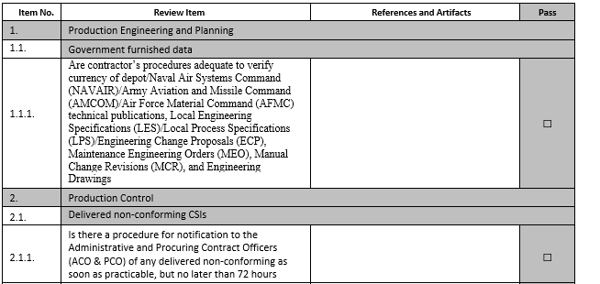
Self-Assessment Checklist
Fill out Self-Assessment Checklist found in Appendix A
Must be signed by the Company President, Owner, or Plant Manager
(This image shows a small part of the actual Appendix)

Slide 18
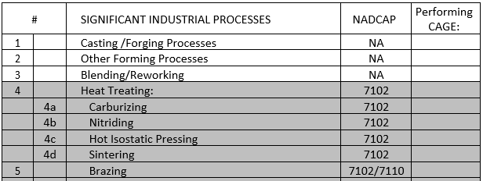
Significant Industrial Process List
Fill out Significant Industrial Process List found in Appendix B
(This image shows a small part of the actual Appendix)

Slide 19
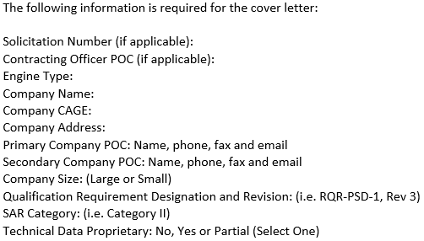
Cover Letter
Appendix C has shows the information required in the SAR Cover Letter
(This image shows a small part of the actual Appendix)

Slide 20
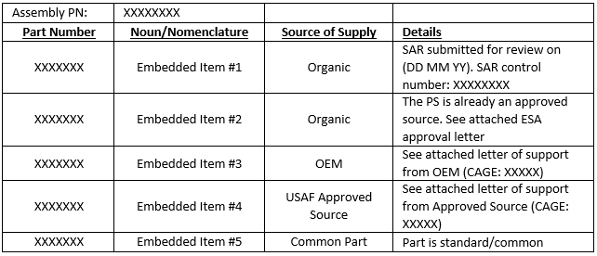
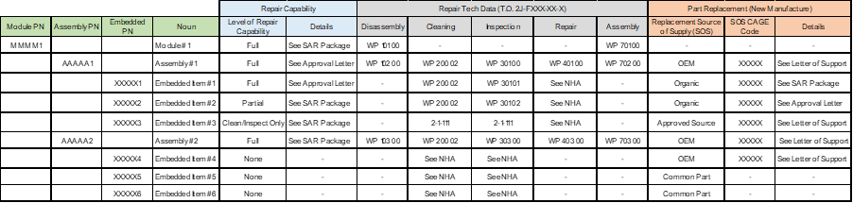
Repair Capability/Source of Supply Matrix for Modules & Assemblies
The table found in Appendix D is only necessary for modules/assemblies
MQR-PSD-1
RQR-PSD-1
(These images show a small part of the actual Appendix)

Slide 21
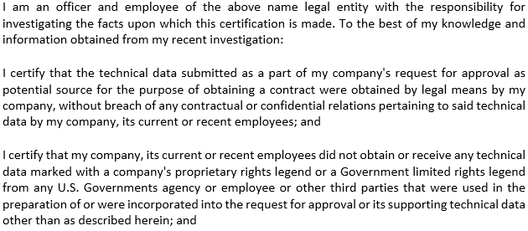
Technical Data Rights Certification Statement
The current version of the TDRCS can be found in Appendix E
Must be signed by the Company President, Owner, or Plant Manager
(This image shows a small part of the actual Appendix)

Slide 22
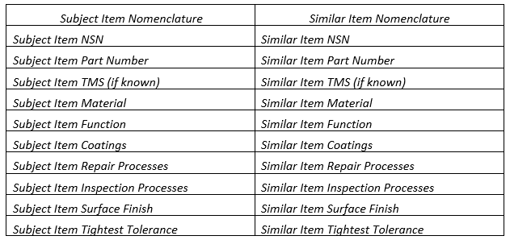
Similar Item Comparison
A sample comparison matrix can be found in Appendix F
(This image shows a small part of the actual Appendix)

Slide 23
Process Change Request (PCR) / Source Resubstantiation Request (SRR)
Only an Approved Source that have produced CSI within three (3) years or
CAI within seven (7) years can submit a PCR/SRR
If a source is currently producing and delivering for the USAF, there is no need for re-substantiation
  If a source stops production and within three (3) years for CSI or seven (7) years for CAI from the last time the item was produced by that source, the source may re-substantiate. If a PS lapses past this timeframe, a full SAR submittal will be required for approval
An approved source that has not delivered the subject item(s) to the USAF may re-substantiate within three (3) years for CSI and seven (7) years for CAI from the time of qualification. If a PS lapses past this timeframe, a full SAR submittal will be required for approval.

Slide 24
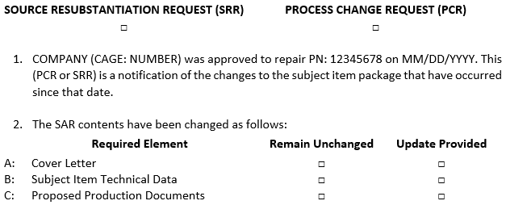
Process Change Request (PCR) / Source Resubstantiation Request (SRR)
The PCR/SRR Form can be found in Appendix G
(This image shows a small part of the actual Appendix)

Slide 25
Qualified Sources – Operational Changes
After becoming a qualified source:
  If a change to your process is required affecting an aspect of your submitted SAR such as changing:
    Sub-tier Suppliers
    Raw Material Suppliers
    Any Industrial Process
    Travelers/Process Operation Sheets
    Inspection Method Sheets
    Machine Location
  To remain qualified, the ESA must be informed of and approve these changes
    Send a process change request listing everything that has changed
    Add any applicable documentation
    The ESA may ask for further information/documentation

Slide 26
Technical Data Request
Request Data or Data Rights Purchases for Drawings
  Public Sales Office (PSO) (405) 736-4676
  ocalc.lgldo.public@us.af.mil
  Provides commercial customers a method to purchase engineering data directly from the ALCs data repository.
  Requires the customer to register with FedBizOps prior to a purchase request.
    submit a request for data or ask questions through the PSO email listed below.
  Offers single or revolving account data purchase options.
  Department of Defense policy mandates only the Data Custodian listed on the Military Critical Technical Data Agreement (DD Form 2345) is eligible to receive data.
Technical Order Home Office
  aflcmc.ezgtp.pubsale@us.af.mil
  Provides commercial customers a method to purchase technical orders directly
  Department of Defense policy mandates only the Data Custodian listed on the Military Critical Technical Data Agreement (DD Form 2345) is eligible to receive data.
Prints
T.O.s
Process defined on SASPO Site

Slide 27
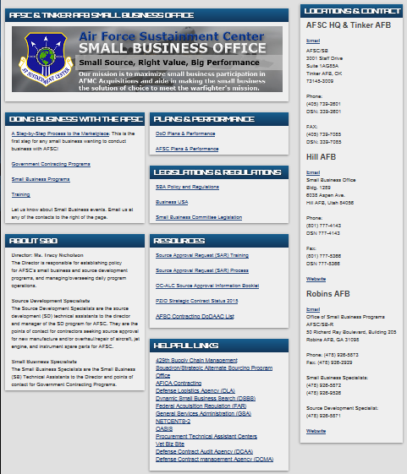
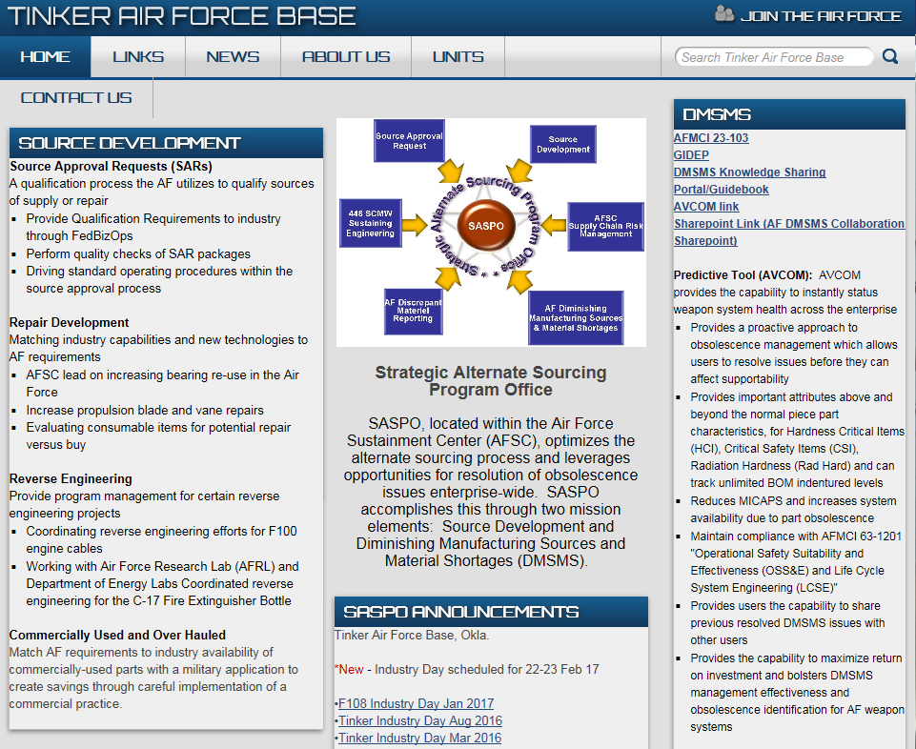
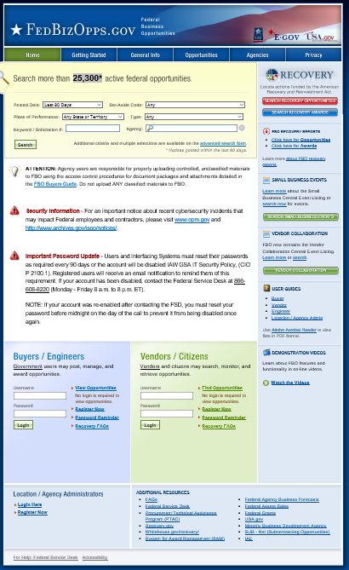
SAR Resources
Focus your SARs / Get Help
Small Business Office
Liaison between Government and all businesses
- http://www.afsc.af.mil/Units/SBO.aspx
SASPO
Strategic Alternate Sourcing Program Office
- RPOW/Target List
- AFMCI 23-113/AFMCI 21-112
- Qualification Requirements
- http://www.tinker.af.mil/Home/429SCMS-SASPO/
SAM
System for Award Management
- Find the NSN(s) from the target list
- Bidding info / dates
- https://beta.sam.gov

Slide 28
Questions?

